Slide 1


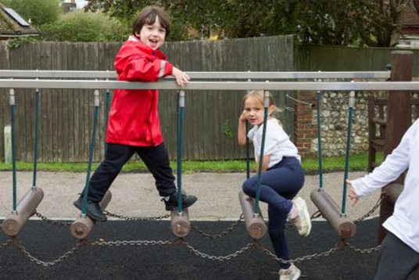
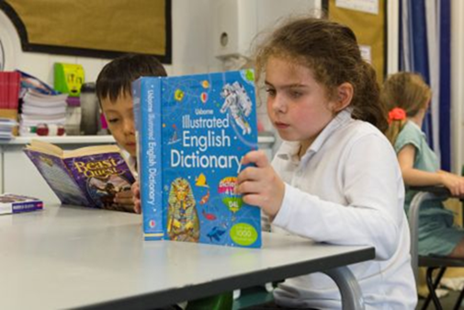
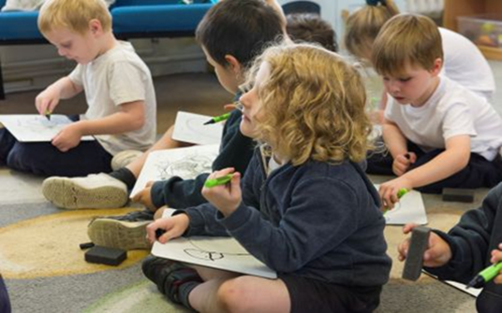
A small and mighty school where everyone can flourish in the heart of the community

Slide 2
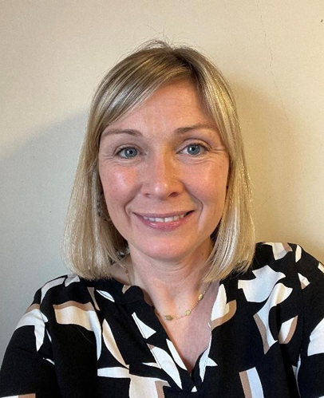
Welcome to Barcombe
“We love that this is a small school where all the teachers and pupils know each other well. The children feel valued here.”
Parent
1

Slide 3
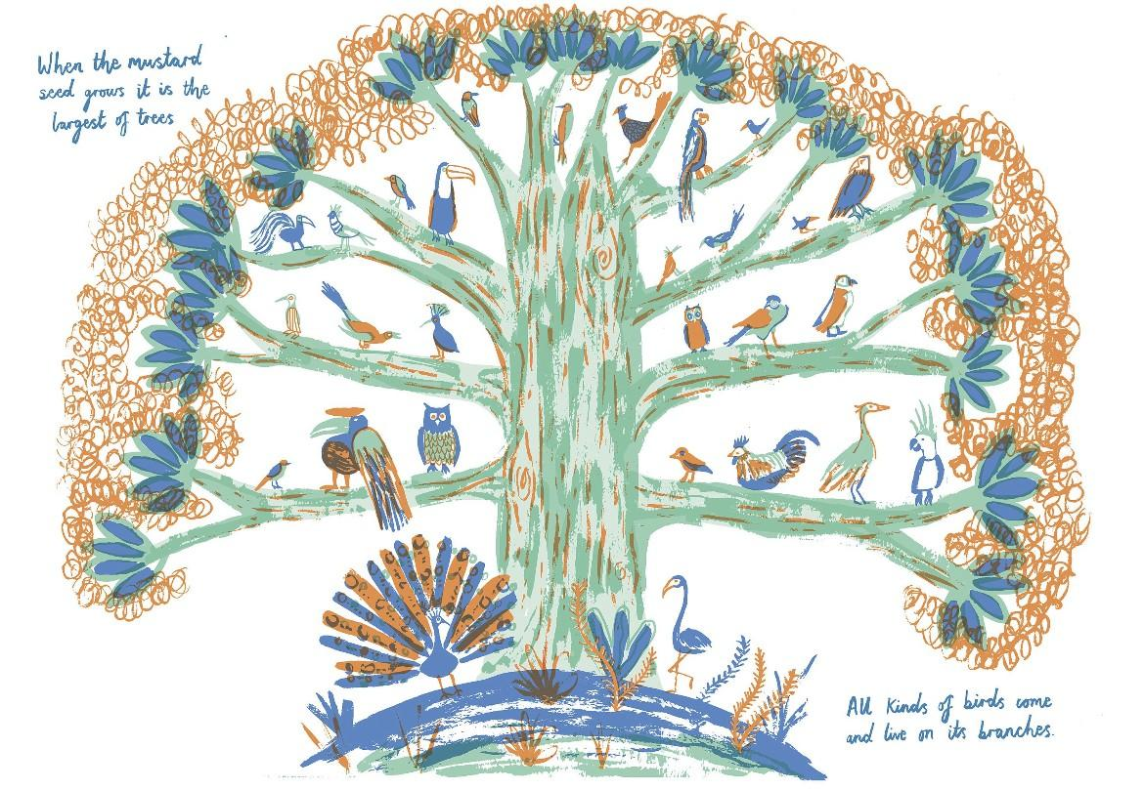
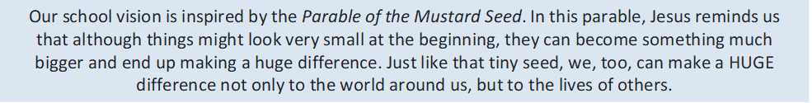

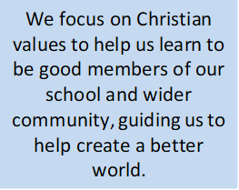
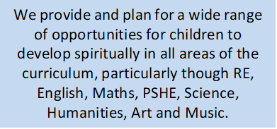
Christian Distinctiveness

Slide 4
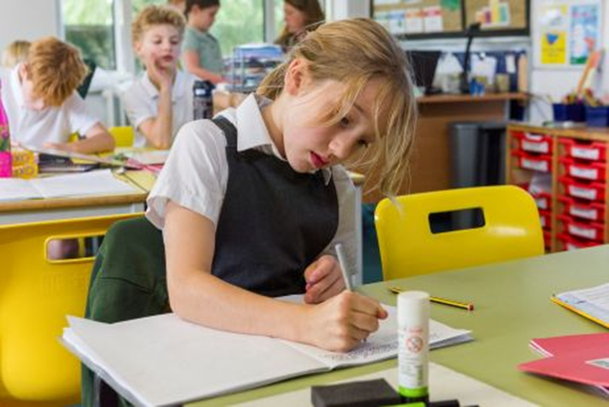

Curriculum
We are particularly proud of our unique Skylark curriculum. We have devised a curriculum that is meaningful, purposeful and relevant to the children who live in this area of East Sussex, nestled at the foot of the South Downs.
The area is rich with local history and geography. We use these subjects as the drivers for our curriculum, allowing our children to truly immerse themselves in a project-based curriculum where subject-specific skills are explicitly taught in a planned, age-appropriate and developmental way. Through the Skylark curriculum, children are taught the importance of analysis as the key to understanding.
We aim to put our children at the centre of their own learning and place great emphasis on nurturing skills and attitudes such as resourcefulness, resilience and co-operation. Our teachers bring the National Curriculum to life by making links between the individual subjects and applying them to whole-school projects.
Our children also benefit from weekly Forest School sessions for at least one term each year.
“Learning here is fun and
active. We get to take part in trips
and workshops as well as fun lessons.
This helps me remember what I have been taught.”
Year 5 Pupil
3

Slide 5
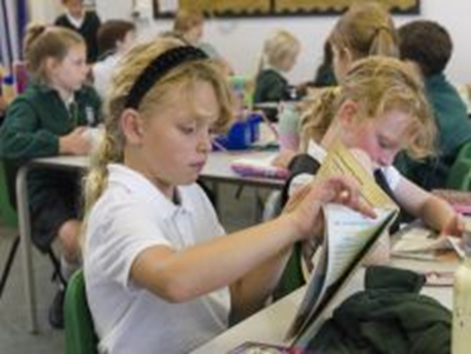
Curriculum
The curriculum is divided into three stages:
Early Years Foundation Stage (EYFS): from ages 4-5
Key Stage 1: from ages 5-7
Key Stage 2: from ages 7-11
Early Years
The Early Years Foundation Stage Curriculum is based on the Government’s Early Learning Goals with seven areas of learning:
Personal, Social and Emotional Development
Communication and Language
Physical Development
Literacy
Mathematics
Understanding the World
Expressive Arts and Design
The children in Early Years are also taught Religious Education and have Forest School. In Early Years, we use Tapestry software to communicate with parents.
Key Stages 1-2
Areas of the curriculum are:
Mathematics
English
Oracy
Science
Computing
History
Geography
Art
Music
Drama
Religious Education
Physical Education
MFL – French
Design Technology
PSHE (Personal, Social, Health and Economic Education)
Forest School
4

Slide 6
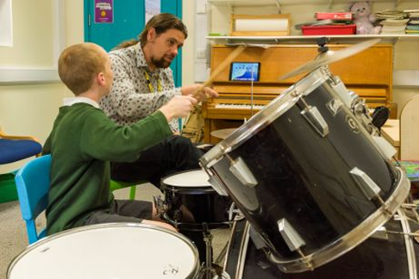
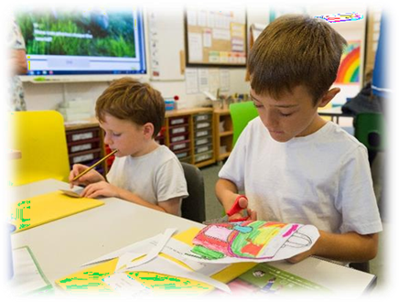
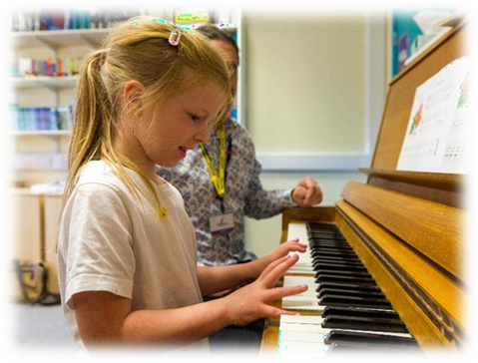
Trips & Workshops
The children are often taken on educational visits to complement their learning in school. Some of the places we have recently visited include:
Lewes Castle, Battle Abbey and Cuckmere Haven.
Residential
Each year our Year 6 children experience a residential trip to Bowles Activity Centre.
Enriched Curriculum
Events
We have specialist STEM days and arrange trips to a local school to use their science laboratories.
We take part in the annual Patina parade too! We have two productions at Christmas; the Key Stage 1 nativity play and the Key Stage 2 carol concert. We also hold a Key Stage 2 production in the summer term.
Celebrations
We love to celebrate the children’s successes individually and collectively. We also celebrate events in the Christian calendar including Harvest, Christmas and Easter.
5

Slide 7
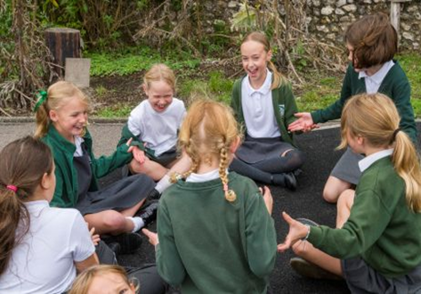

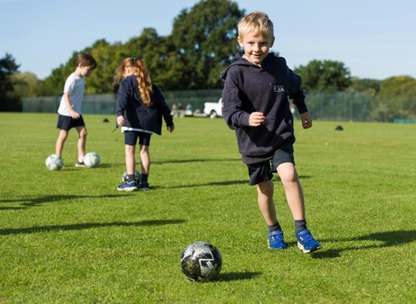
Forest School, Sport,
Clubs and Pupil Voice
Forest School
We are very fortunate that the children have access to the Wild about Barcombe area for forest school. There, children follow a full programme with our forest school staff. Every year group gets at least a six-week session learning new skills.
“I love this school and its hardworking and inspiring staff.
Children are well
looked after here.”
Parent
Sport
We believe that physical development is a key component to success across the whole curriculum and we have excellent PE provision. Our children take part in a range of sports within class PE lessons, as well as inter-federation events.
6

Slide 8
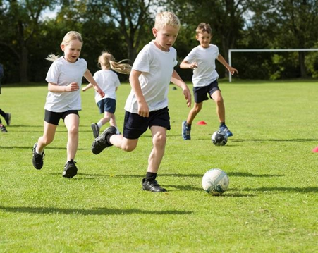
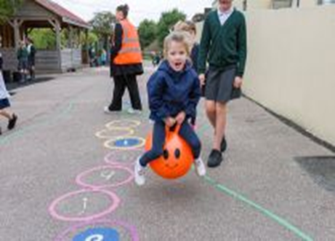
Clubs
We have a thriving breakfast club and after-school club. Breakfast club runs from 7.45am Monday to Friday. After-school club runs until 5.30pm Monday to Friday.
We also have a number of specialist clubs that change and can include:
French (Reception to Year 2 and Year 3 – Year 6)
Sports cool
Indoor tennis
Choir
KS2 Football
Art Club
Pupil Voice
Our School Councillors are elected from every class. They have regular meetings to discuss the school before sharing their recommendations.
We also have Worship Wardens, librarians, Year 6 buddies, digital leaders, Play Leaders and Team Captains.
7

Slide 9
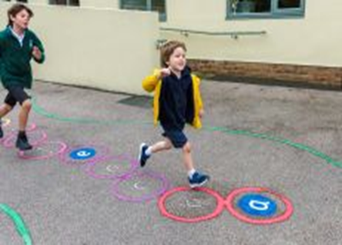
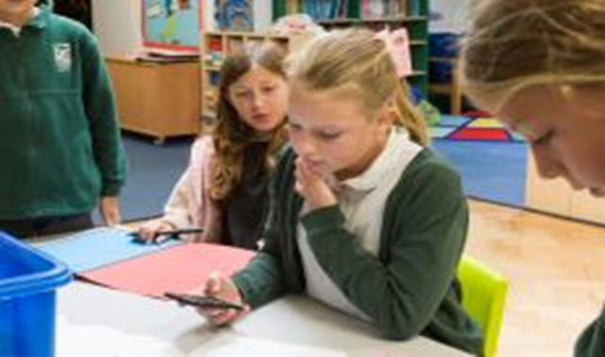
Inclusion
Special Education Needs and Disabilities
We believe that all children need to feel safe, happy and valued at school in order to learn, progress and develop their well-being.
We recognise the individuality of all children and the fact that they are at different levels of development physically, emotionally, intellectually and socially.
Staff recognise the need for adaptation in setting tasks for pupils. Teachers regularly hold pupil progress meetings with leadership and our SENCo to discuss any interventions required to support each child.
We are committed to working in partnership with families, and in involving them and their children in decisions about learning and progress.
Arrangements are in place in school to support pupils with medical conditions.
Pupils with SEND are encouraged and supported to participate fully in the life of the school and in any wider community activities.
“He is enjoying being
challenged and continues to love learning new
things.”
Parent
8

Slide 10
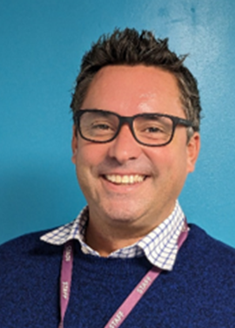
Admissions
Barcombe CE School is an inclusive school where everyone is welcome. East Sussex County Council are our admissions authority, and they request that all applications are submitted online. Our school’s Published Admission Number (PAN) is 20.
Governors
We have an active Governing Body who meet regularly and monitor areas of the school. They support and challenge every aspect of school activity, from the highest academic aspiration, to everyday housekeeping.
This ensures there is overall improvement, progress and achievement, and that each child is encouraged to fully realise their potential.
Executive Head Teacher
I hope you have enjoyed reading about our school. My name is Stewart James, and I am the Executive Head Teacher of the Skylark Federation, formed of Barcombe CE, Hamsey CP, Iford & Kingston CE and Plumpton Primary Schools, four wonderful schools on the outskirts of Lewes.
I am passionate about the unique experience children attending small village schools receive, however I am also acutely aware of the challenges that face small schools working in isolation.
I believe the federation provides the structures and capacity of a large school whilst still maintaining the unique ethos of small schools. I am incredibly proud of the success the federation has brought to the children who attend the Skylark Federation schools.
9

Slide 11
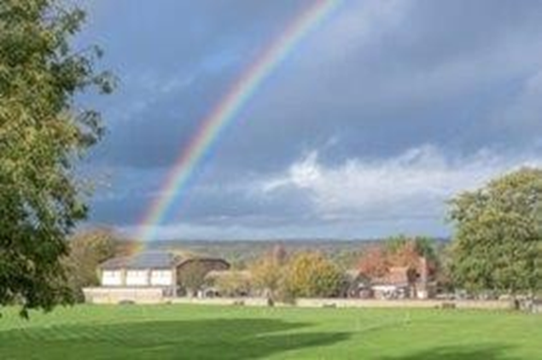
Barcombe CE Primary School
A small and mighty school where everyone flourishes
in the heart of the community
School Path, Barcombe Nr Lewes, East Sussex BN8 5DN
https://www.Barcombe.e-sussex.sch.uk
Email: barcombeoffice@skylarkfed.education
Phone: 01273 400287

