Slide 1
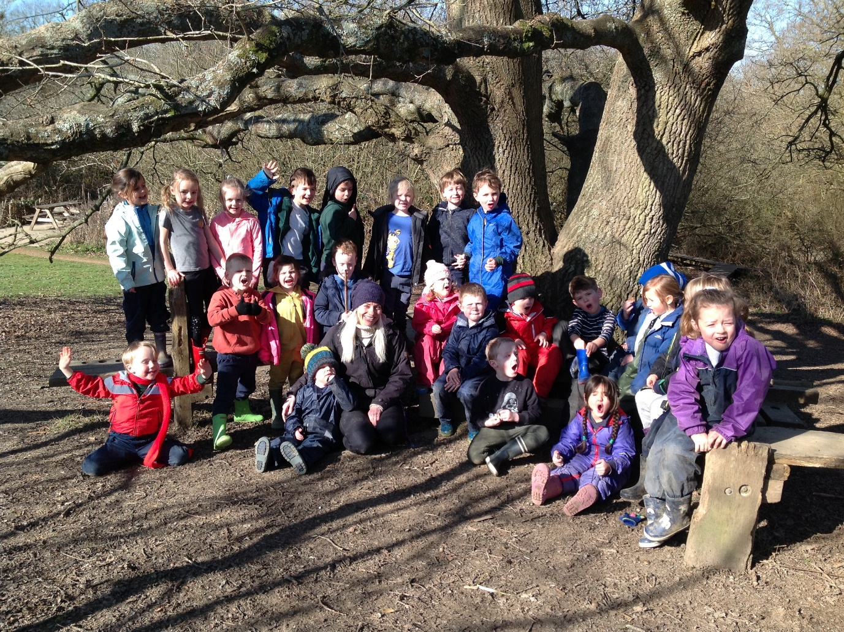
Welcome to Barcombe Primary School

Slide 2
Current structure of the Early Years Foundation Stage
Hedgehog Class – Early Years
Miss Amy Eaglen – Class Teacher
Mr Richards –Teaching Assistant
Mrs Hills - INA

Slide 3
Early Years Foundation Stage Curriculum
Barcombe School follows the ‘Early Years Foundation Stage Guidance’ which supports each child to take their next steps and follow their learning interests.
Our curriculum is play-based, filled with practical and fun experiences to support thinking and learning.

Slide 4
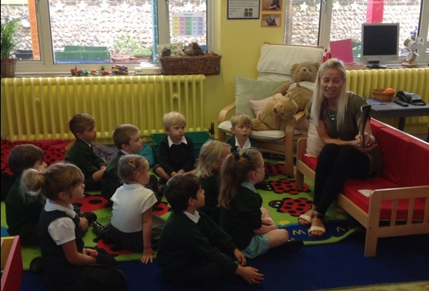
Transition from Pre-school
Phone calls to pre-schools
Handover of information about your child
Transfer of Tapestry (online learning journal)
Story videos on the website.
A Little Bit Brave activities from home to school.
Stay and Play session
Teddy bear’s picnic
Family Meeting
Staggered start
(4 days)

Slide 5
Transition Events
Stay and Play session -July 4th or July 5th 1.30-2.30pm
Teddy Bear’s Picnic – 13th July 11.30-1pm
Family Visit
Staggered start timetable
Please see your pack for which sessions you can attend.

Slide 6
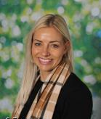
Meet your teacher
Miss Eaglen will be your teacher in September.
Please ask me any
questions of say
hello today!

Slide 7
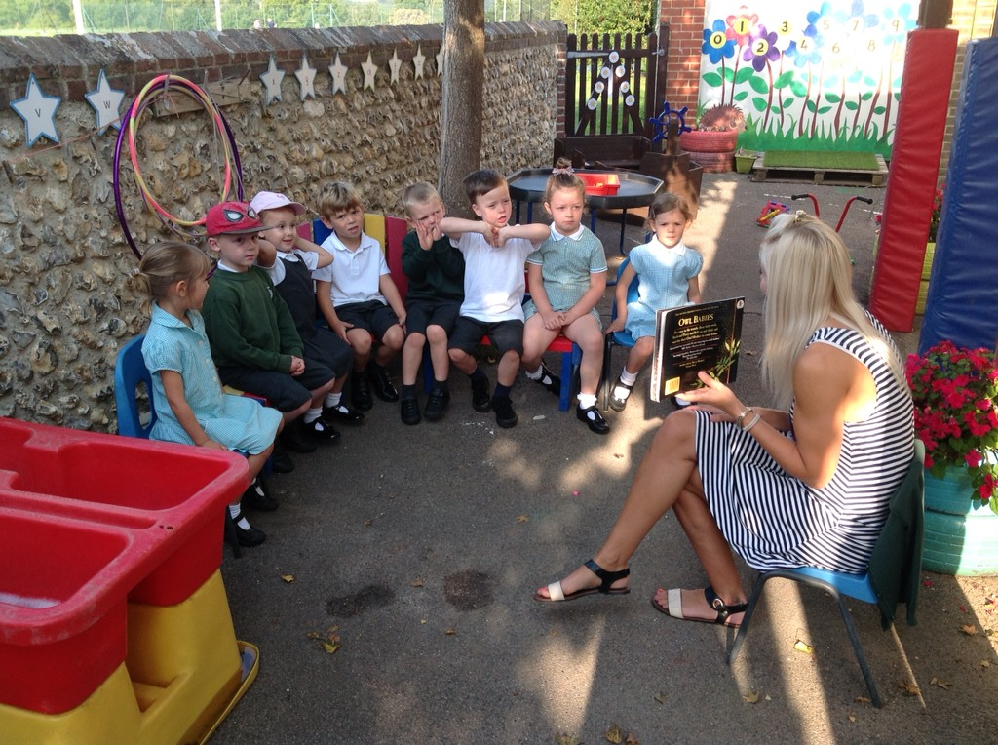
Stay and Play
Stay and play session for you and your child to become familiar with our new environment.
Small groups.
Meet your Year 6 Buddy.
Time to go inside the
Classroom with your child
and have a look around.

Slide 8
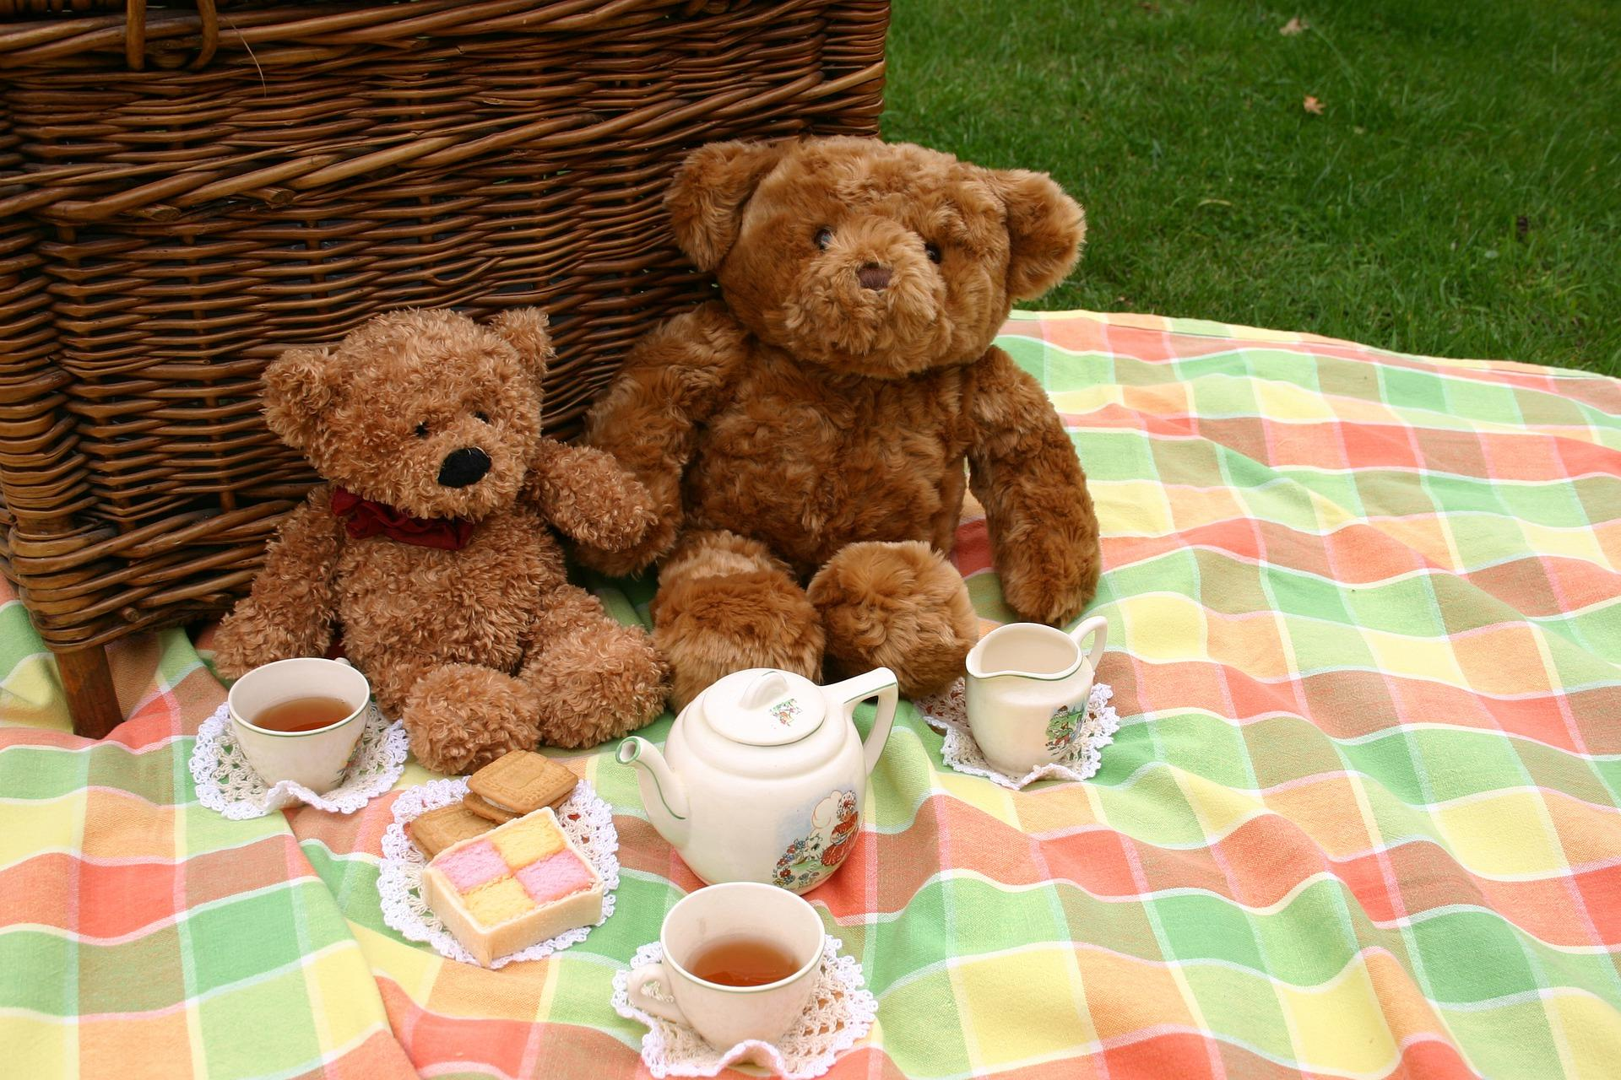
Teddy Bear’s Picnic
Thursday 13th July -11.30 – 1pm
Under the Oak tree, at the top of the Rec

Slide 9
Family School Visit
An opportunity for us to meet you and your child in their new classroom and talk with you about their experiences so far.
Family School Visits will take place Monday 4th September, Tuesday 5th September and Wednesday 6th September,
between 9am and 3pm (see welcome pack for your time).

Slide 10
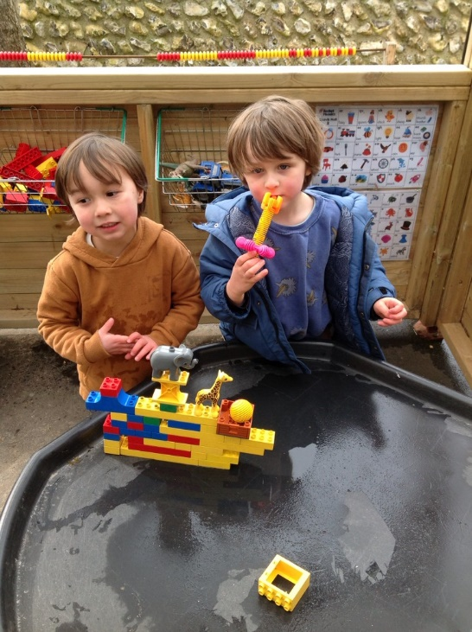
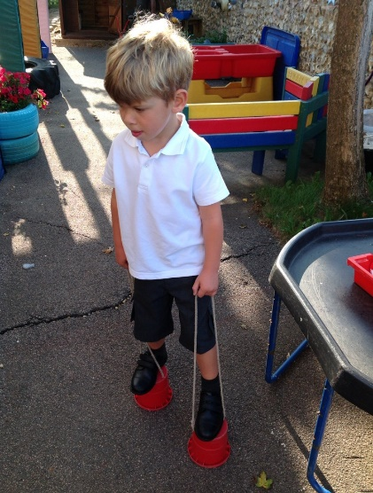
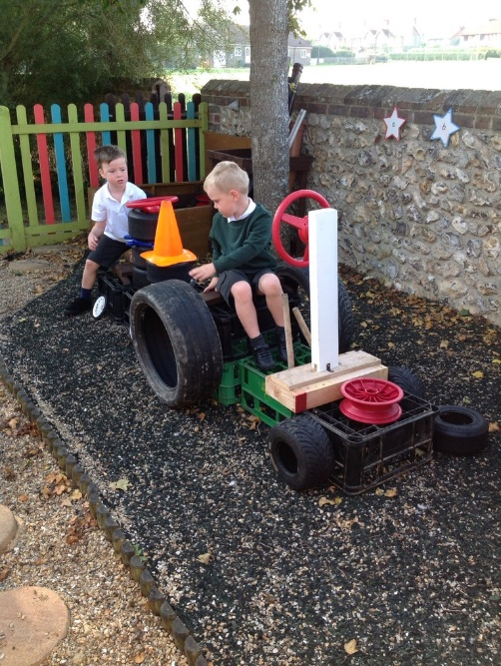
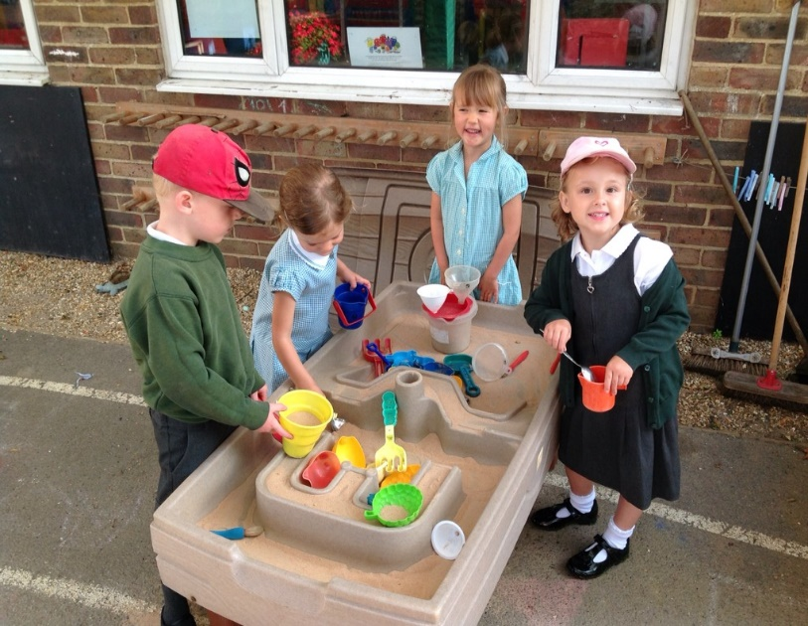
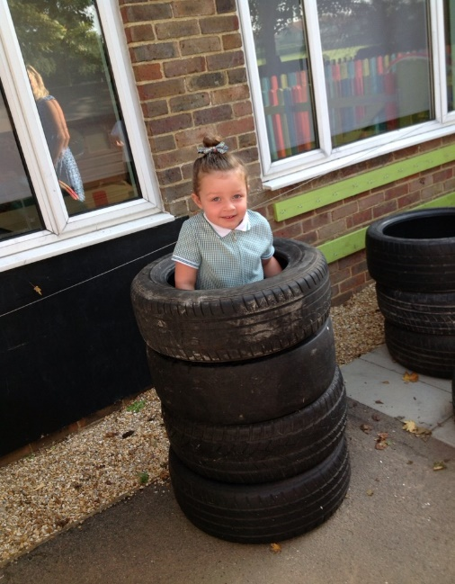
What might you see?

Slide 11
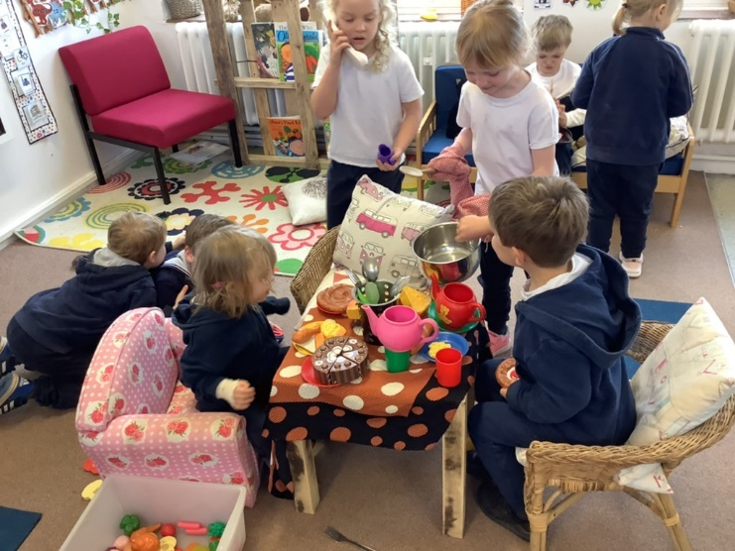
A Good Start
Half day sessions for 4 days
– Your child will be in school for either a morning or an afternoon each day.
Small groups so we can all get to know each other.
All children have experience of lunch times before full time.
All children come full time from Thursday 14th September.
- If you feel your child would benefit from being part time for a little longer, please speak to Miss Eaglen.
We want starting school to be a positive and happy next step for all children.
Please see your pack for full details of our transition timetable.

Slide 12
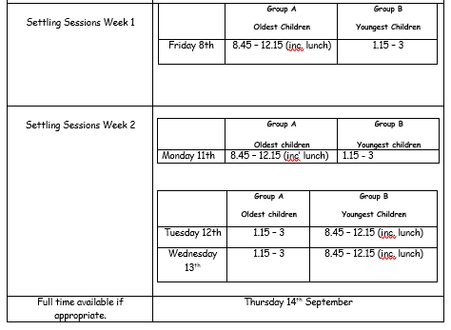
Family meetings – 5th 6th 7th September

Slide 13
A day in Hedgehog Class…
8.45 Bell rings on the playground and we all line up and walk into class together.
8:45-9:00 Self-initiated play inside/outside
9.00 – 10.00 Maths or literacy
Teacher led focus groups / self-initiated learning inside and outside
10:00-10:30 Snack and milk time
10.30 - 11.00 Phonics
11.00 – 12.00 Maths or literacy
Teacher led focus groups / self-initiated learning inside and outside
12:00-1:00 Lunch time
1:00-1:15 Register and relax time/circle time
1:15-2.30 Topic learning, 1:1 Reading, teacher led focus groups /self-initiated learning
2.30-3.00 Show and Tell, and Story

Slide 14
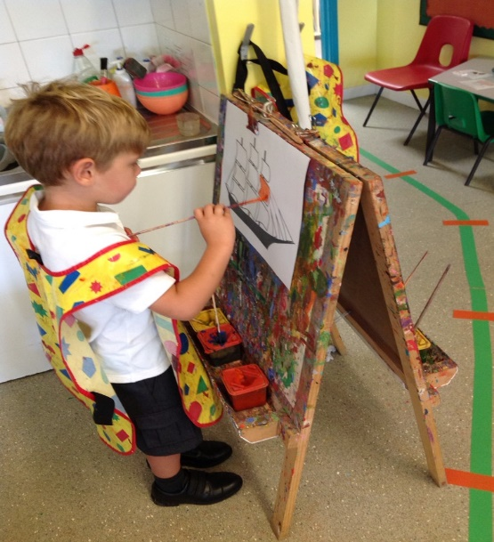
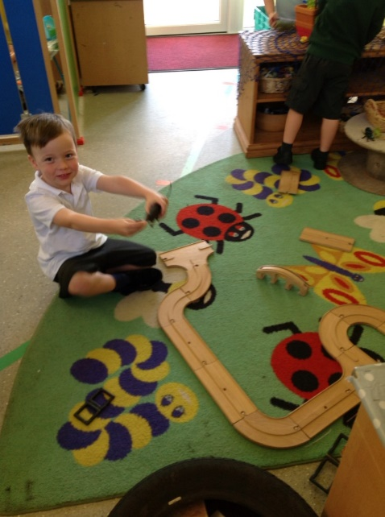
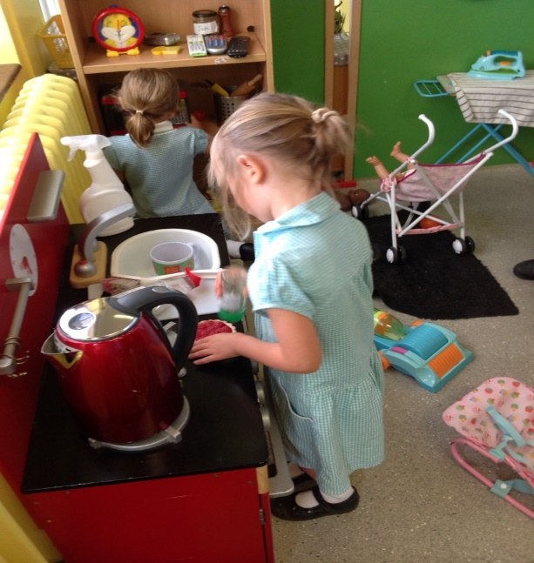
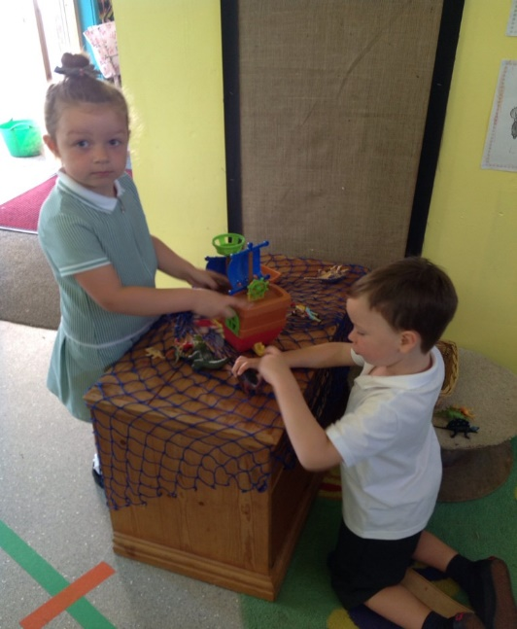
Inside our classroom…

Slide 15
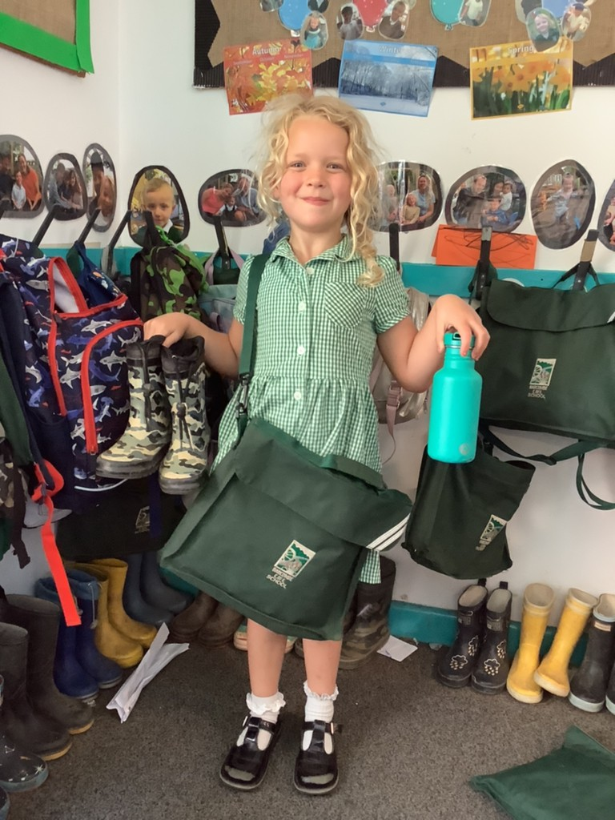
What do I need to bring?
School Uniform
Bag with a change of clothes
Welly Boots
Water bottle
Something special
Healthy snack – Fruit/
oat bar/crackers/rice cake
I will give you your book bag
on your first day at school.

Slide 16
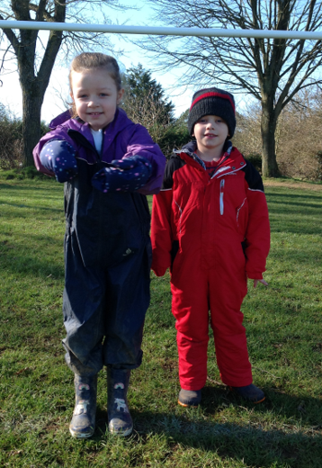
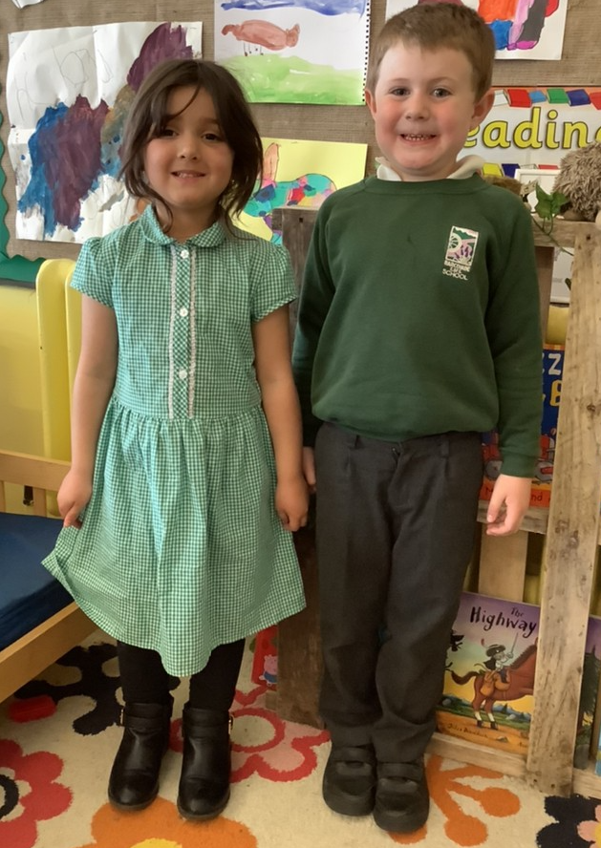
School Uniform
On PE days we come to school in our PE kit for the day.
School Uniform
Welly Walk Days!

Slide 17
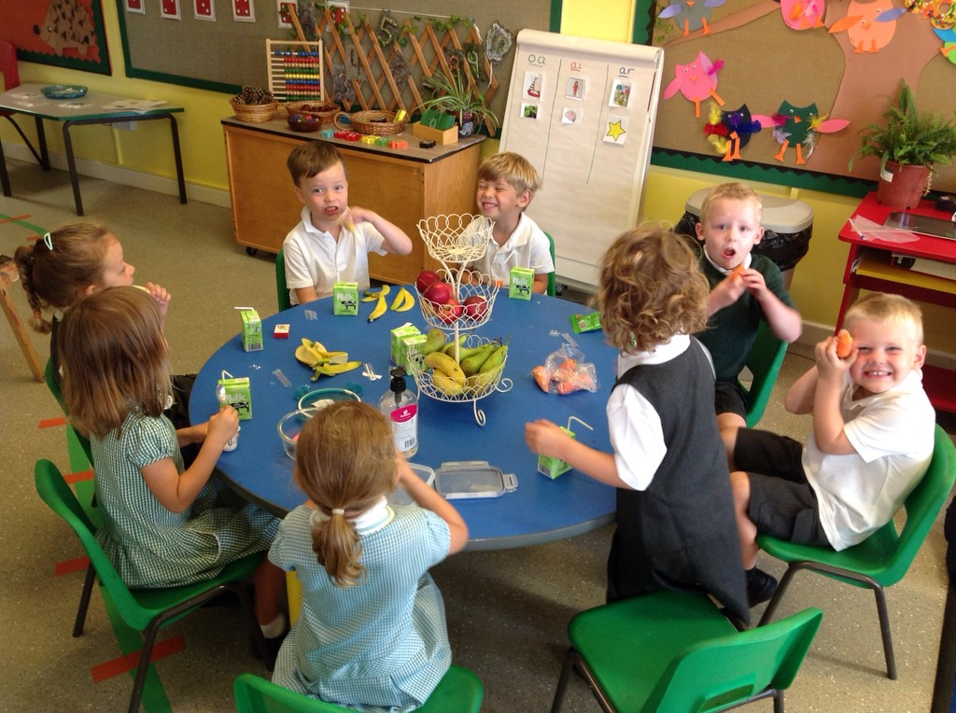
Snack time
Everyday we have a selection of fruit available for snack time.
You may want to send in a healthy snack that you know your child will eat as well. Please pop it in a named pot.
Milk is free and
available to all
children under
5 years old.

Slide 18
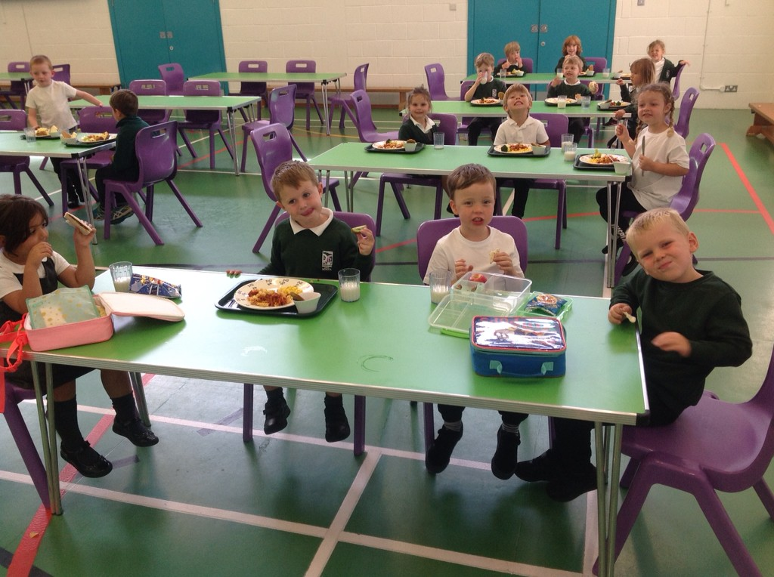
Lunch time
Free school meals for reception children.
Or packed lunch.
Lunch menu is in your pack.
Children can choose each morning what they would like for lunch.
We will all sit together and our Year 6 buddies will help us.
Miss Eaglen will settle the
children in the
lunch hall/Sports hall.
After lunch, we all go out to
the Playground for a play
with our friends and year 6 buddies.

Slide 19
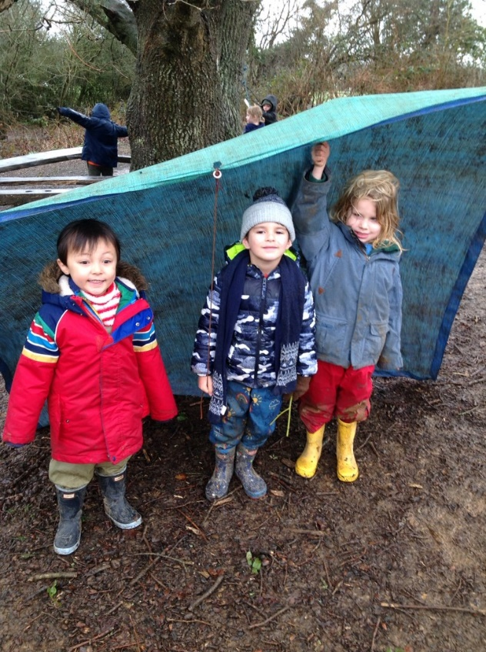
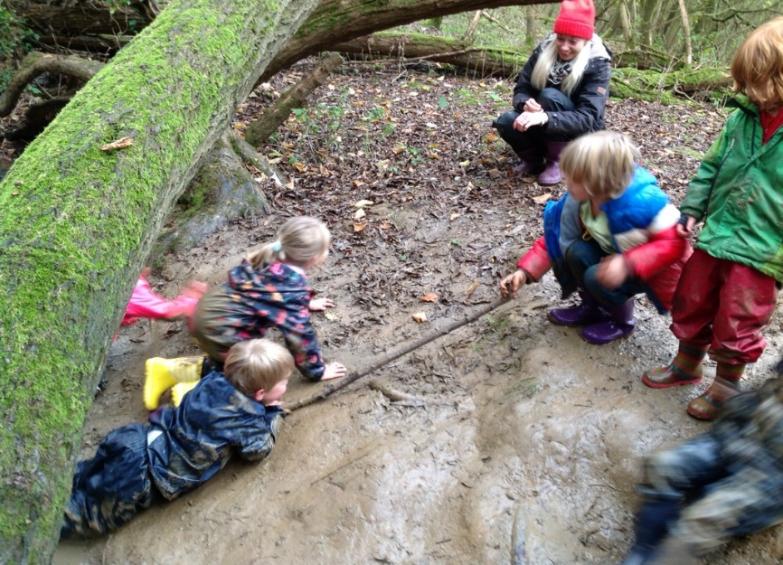
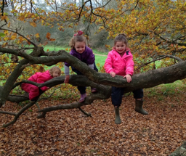
Welly walks
Every Wednesday we go on a Welly Walk to Wild About Barcombe.
We wear our old clothes and a waterproof suit, so we can have lots of fun and keep dry and warm.
This is super time to grow our
friendships and self-confidence.

Slide 20
If you have questions do contact the school office and we will respond.
Miss Eaglen can give you a call if necessary.

