Slide 1
Welcome to our
Phonics Workshop

Slide 2
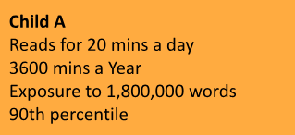
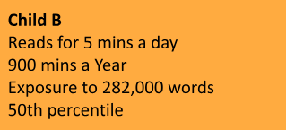
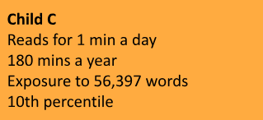
Why is reading so important?
Children who are read one book a day will hear about 290,000 more words by age 5 than those who don't regularly read books with a parent or caregiver.

Slide 3
Before a child can read a book they need to be aware that:
-Print has meaning
-Print can have different purposes
-We read English texts from left to right
-Page sequencing
-The names of different parts of the book

Slide 4
Phonological awareness:
The next step is to develop word reading skills. Children learn to read individual letters by saying the sounds for them and then blending the sounds into words so they can read short words.
sat

Slide 5
Notes:
2 letter-sounds a week and longer sessions

Slide 6
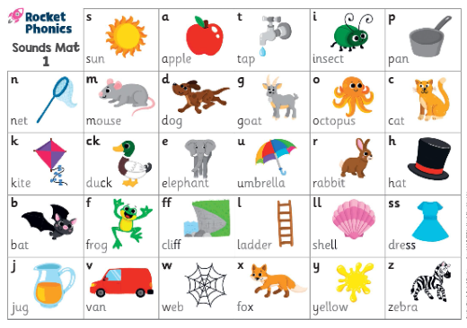

Slide 7
How to say the sounds
The children are taught to say the ‘pure’ sound – the shortest form of the sound.
m isn’t muh, v isn’t vuh
Here is a great video demonstrating how to say all of the 44 sounds:
https://www.youtube.com/watch?v=zX7dmuB4fNg

Slide 8
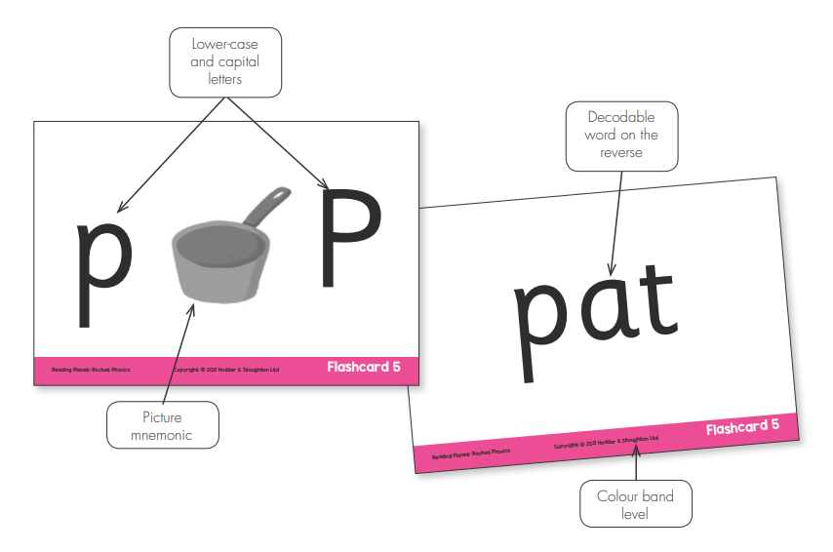
Flashcards

Slide 9
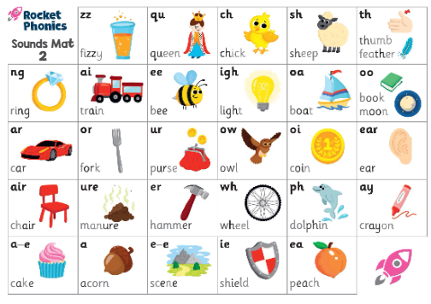

Slide 10
We teach the children to look for the digraphs/trigraphs when reading.
sheep card

Slide 11
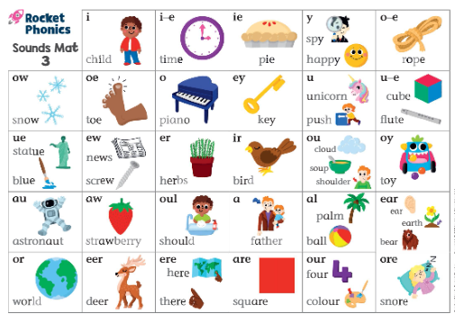

Slide 12
We teach one sound every two days.
Day 1 – Blending (reading)
Day 2 – Segmenting (writing)
Writing often takes much longer for children to develop. There are many more skills involved.
-segmenting the word in order to spell it
-find the correct grapheme to represent the sound (igh, i, ie, i-e)
-hold the pencil and form the letters

Slide 13
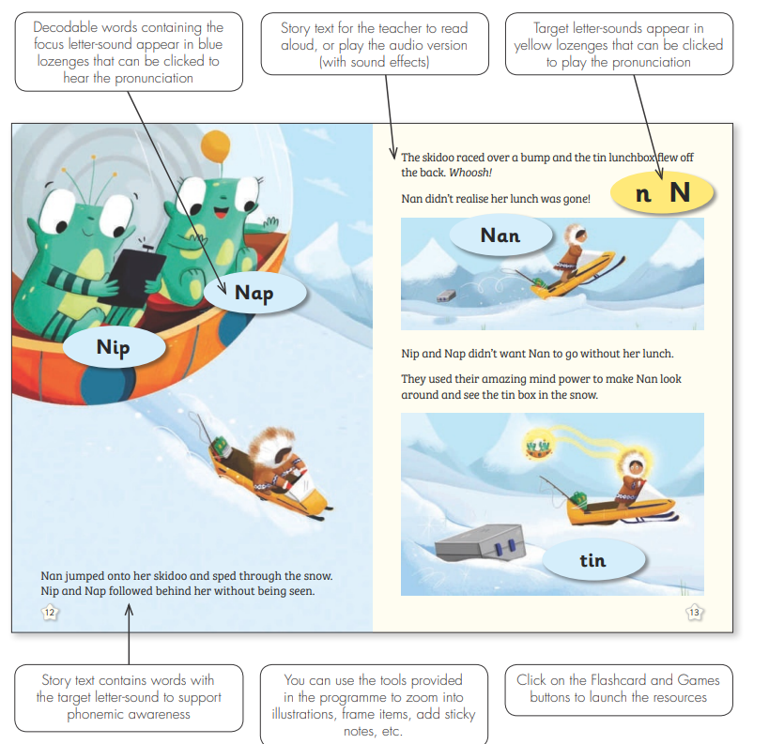
A Rocket Phonics lesson

Slide 14
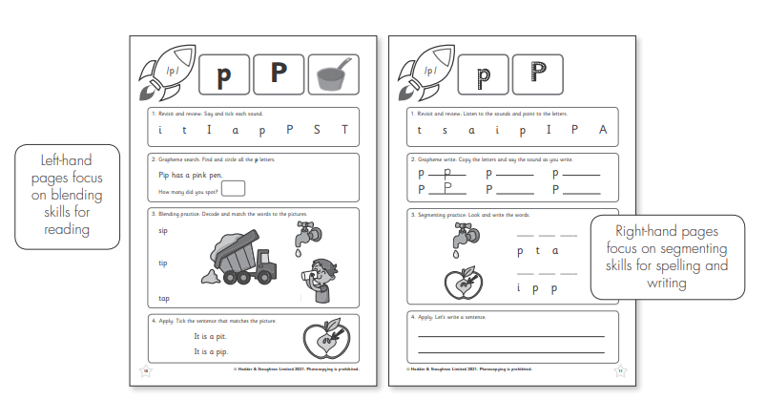
Workbooks
Notes:
Practise blending and segmenting skills at letter-sound, word, sentence and text level depending on where they are in their reading journey.

Slide 15
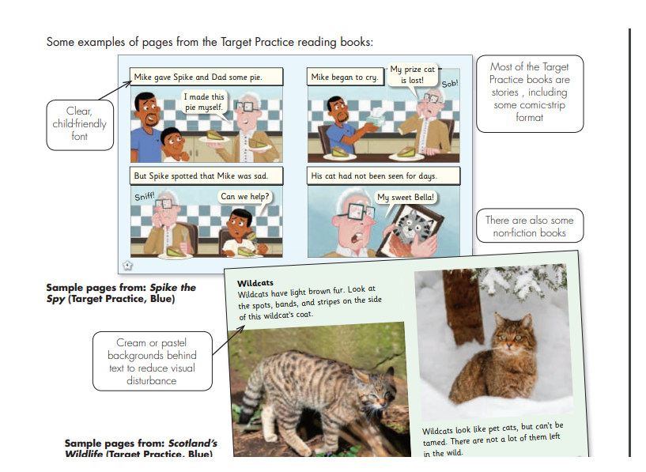

Slide 16
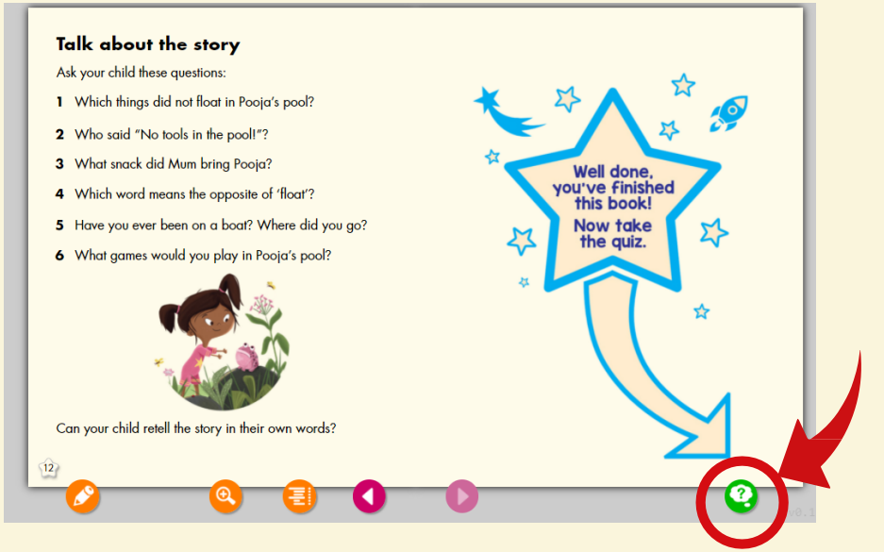
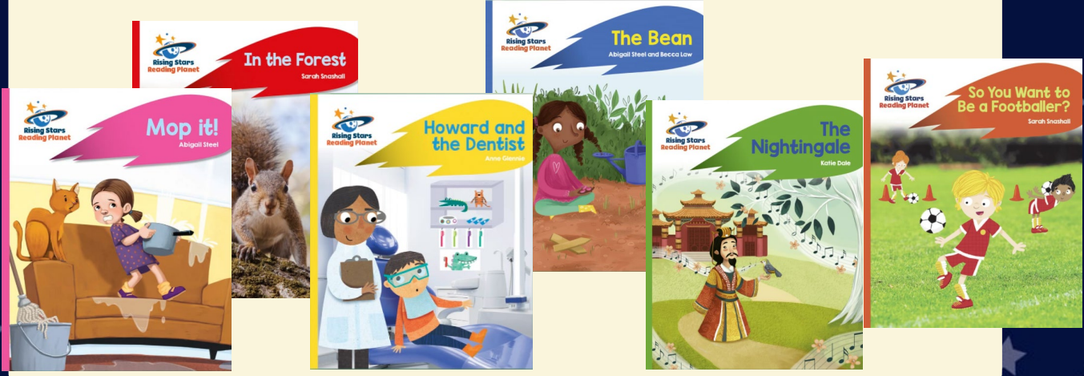
How can I support my child?
*A phonics reader book will be sent home
*Rocket phonics online e-books will be available with comprehension quizzes and questions
Notes:
Books being sent home
Rocket phonics online e-books – link to books being read in school.

Slide 17
Differentiation
Each sound can be approached at a different level: letter-sound, word, sentence, text.
Challenge in booklets.
Personalised learning.
Rocket Phonics encourages early exposure to sounds.

