Slide 1
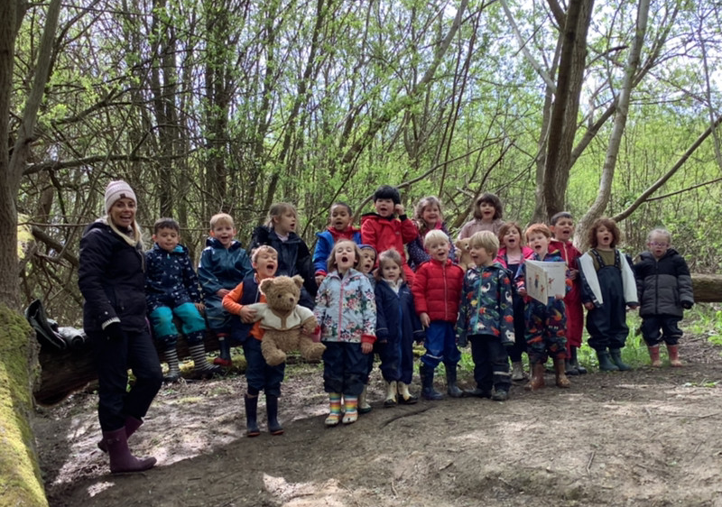
Welcome to Barcombe Primary School!

Slide 2
Class Structure
Hedgehog Class – Early Years & Year 1
Miss Amy Eaglen – Class Teacher
Mrs Kirsty Hills–Teaching Assistant

Slide 3
Early Years Foundation Stage Curriculum
Barcombe School follows the ‘Early Years Foundation Stage Guidance’ which supports each child to take their next steps and follow their learning interests.
Our curriculum is play-based, filled with practical and fun experiences to support thinking and learning.

Slide 4
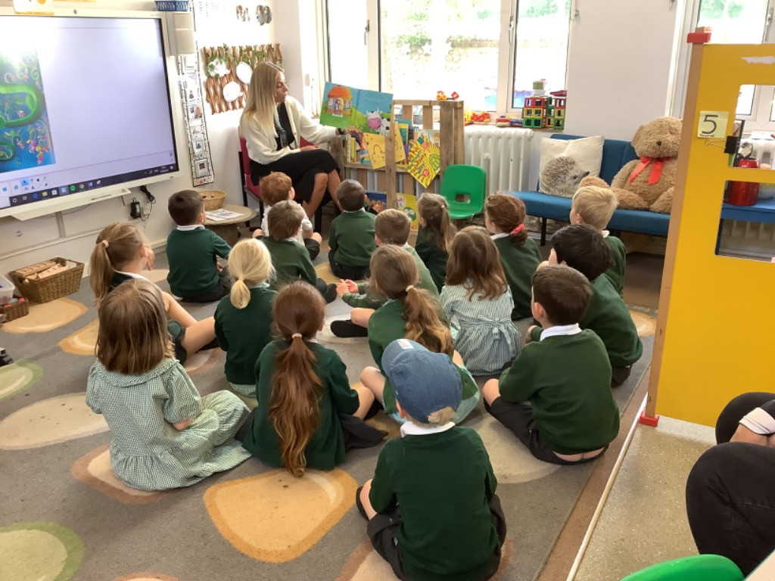
Transition from Pre-school
Contact with pre-schools.
Teacher visits to Playgroup
Playgroup play sessions in Hedgehog garden.
A Little Bit Brave
activities.
Story videos on
the website.

Slide 5
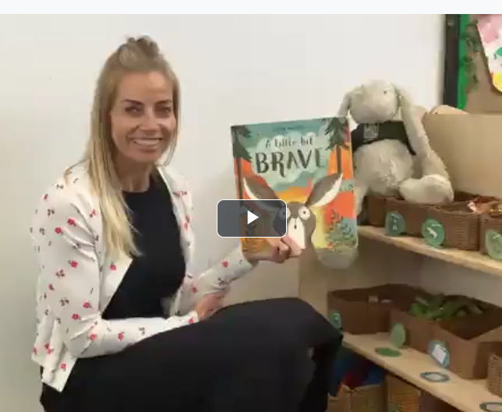
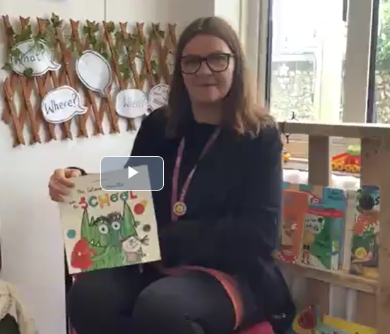
School Website Story Videos
Useful Information tab
New to Reception 2024

Slide 6
Transition Events
Stay and Play session -1.30-2.30pm
Group A -Wednesday 26th June
Group B -Thursday 27th June
Teddy Bear’s Picnic –
Friday 5th July - 11.30-12.30pm
Home Visits – September 4th/5th/6th
Staggered start – 4 Half day sessions.
Please see your pack for which sessions you can attend.

Slide 7
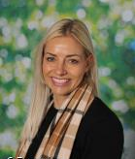
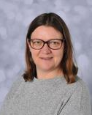
Meet your teacher
Miss Eaglen will be your
teacher in September.
Mrs Hills will be your TA.
Please ask us any questions
& say hello today!

Slide 8
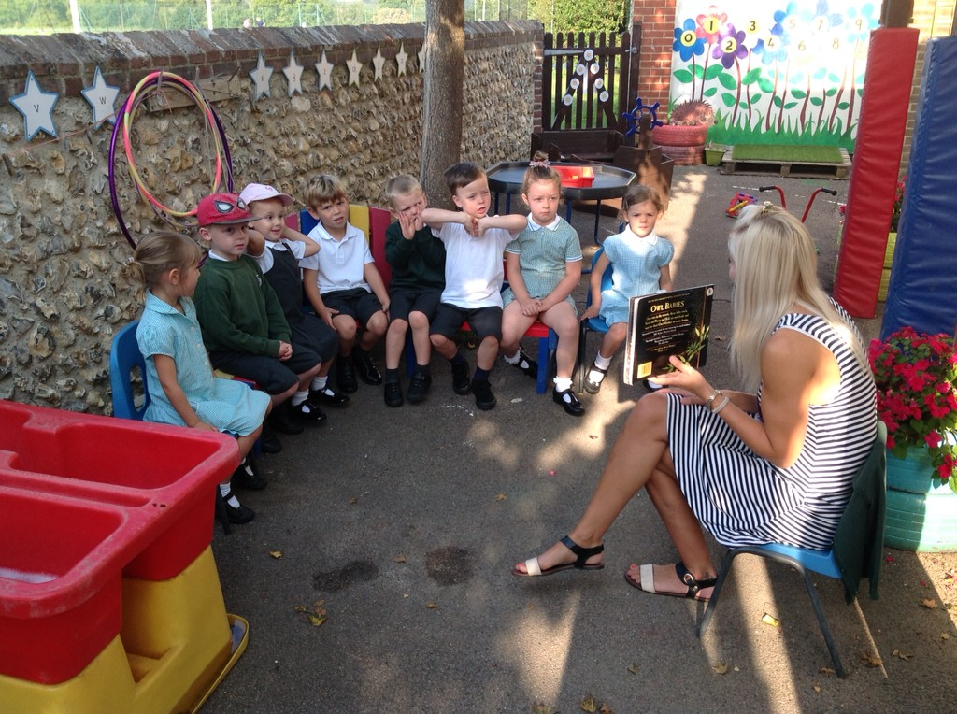
Stay and Play
Stay and play session for you and your child to become familiar with our new environment.
Half the class.
Meet your Year 6 Buddy.
Time to play and be in the
classroom environment
with your child.
Wednesday 26th June or
Thursday 27th June

Slide 9
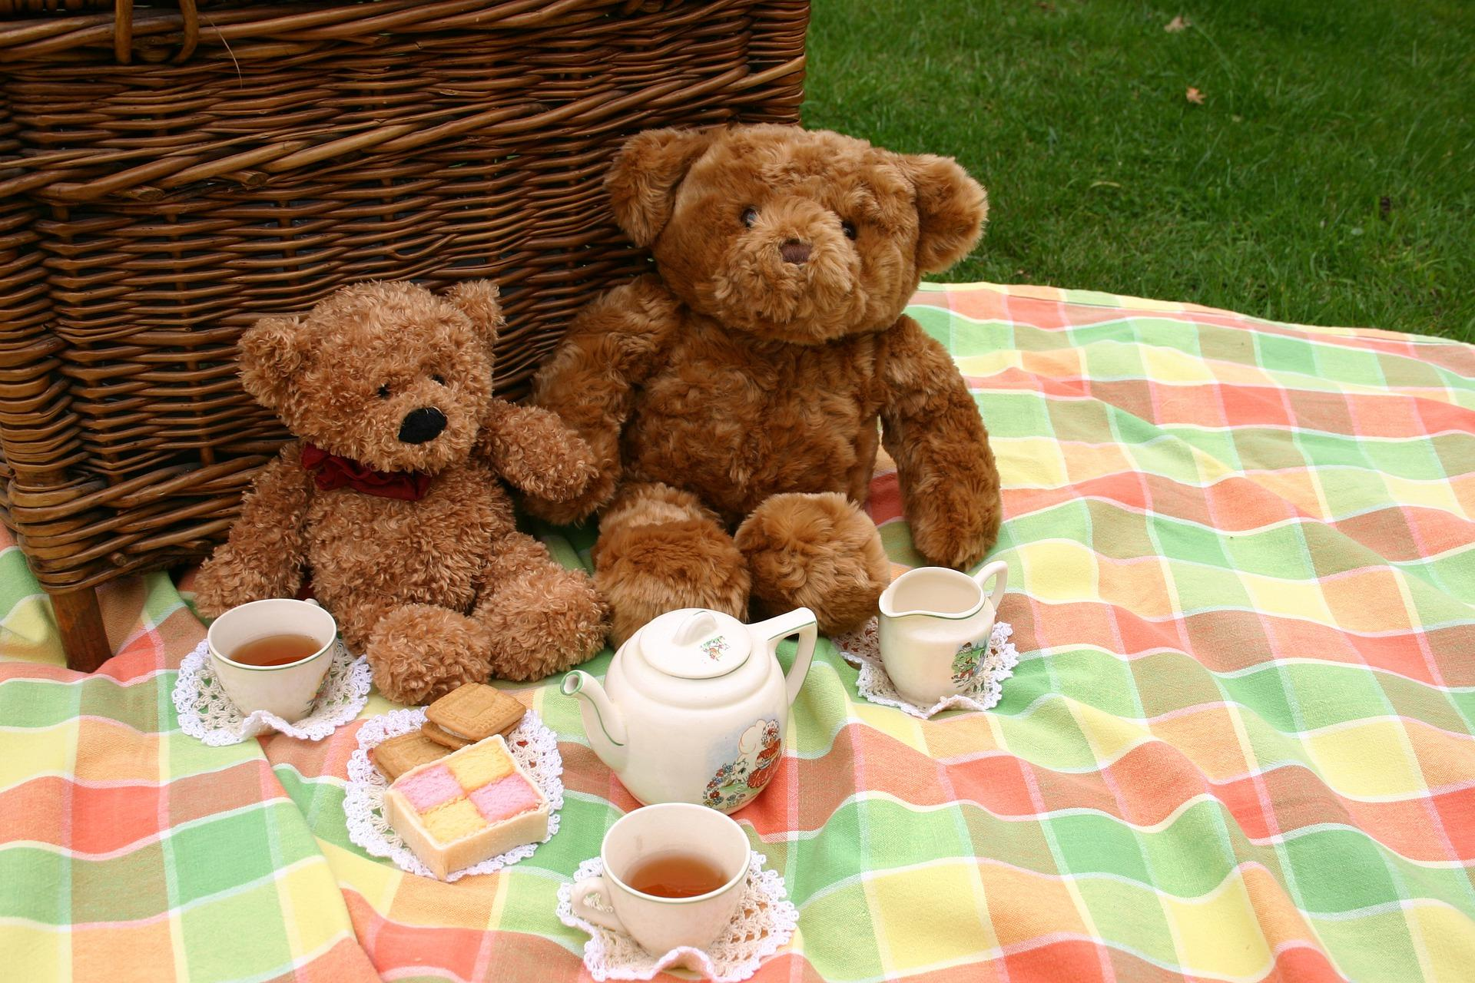
Teddy Bear’s Picnic
Friday 5th July -11.30 – 12.30pm
Under the Oak tree, at the top of the Rec
Bring your own picnic and bear.
Current Hedgehog class will join us.
Time to play together.
Get to know new friends and parents.

Slide 10
Home Visits
An opportunity for us to meet you and your child in a relaxed home environment.
Time to talk with you about your child’s experiences so far.
A chance to ask any questions and share any key worries or information.
Time to reacquaint ourselves before starting school.
Home Visits will take place
Wednesday 4th September, Thursday 5th September and Friday 6th September,
between 9am and 3pm
Please see welcome pack for your date and time.

Slide 11
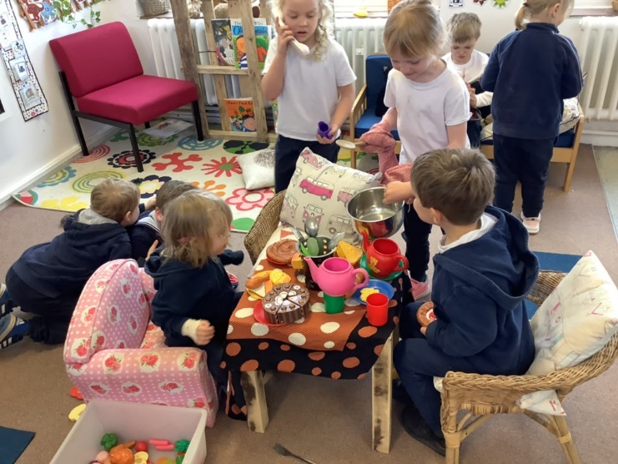
A Happy Start to School
Half day sessions for 4 days
Your child will be in school for either a morning or an afternoon each day.
Smaller groups so we can all get to know each other.
All children have experience of lunch times before full time.
All children come full time from Friday 13th September.
If you feel your child would benefit from being part time for a little longer, please speak to Miss Eaglen.
We want starting school to be a positive
and happy next step for all children.
Please see your pack for full details of our transition timetable.

Slide 12
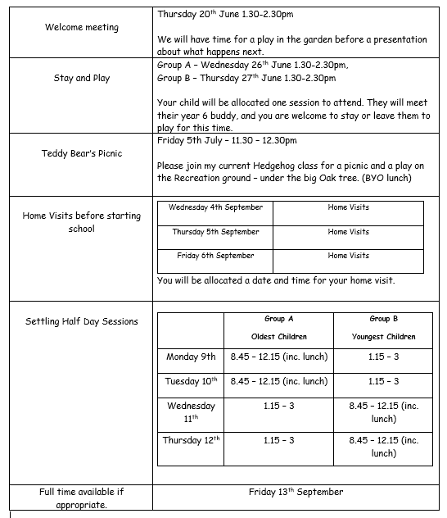
Transition events sheet is in your pack.

Slide 13
A day in Hedgehog Class…
8.30-8.45 Parents can bring children into Hedgehog class and settle them and say goodbye.
8:45-9:00 Self-initiated play inside/outside
9.00 – 10.00 Maths or literacy
Teacher led focus groups / self-initiated learning inside and outside
10:00-10:30 Snack and milk and relax time
10.30 - 11.00 Phonics
11.00 – 12.00 Maths or literacy
Teacher led focus groups / self-initiated learning inside and outside
12:00-1:00 Lunch time
1:00-1:15 Register and relax time/circle time
1:15-2.30 Topic learning, 1:1 Reading, teacher led focus groups /self-initiated learning
2.30-3.00 Show and Tell, and Story

Slide 14
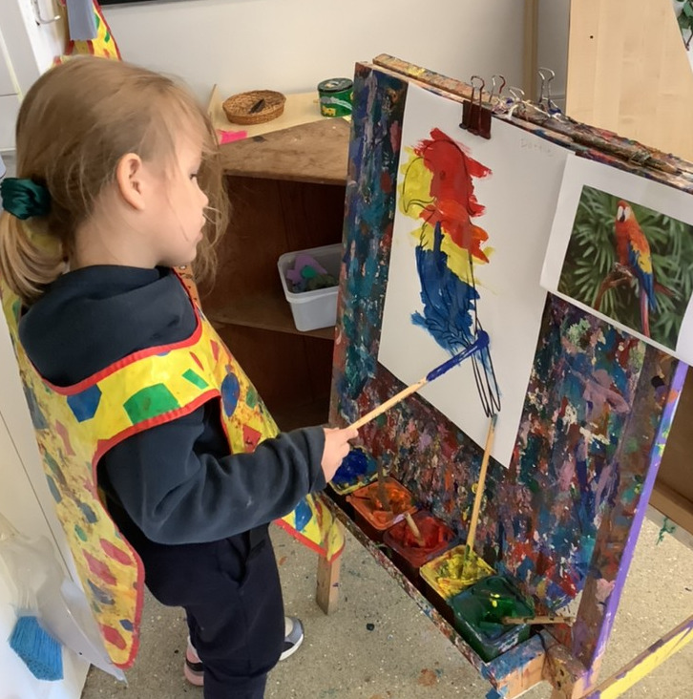
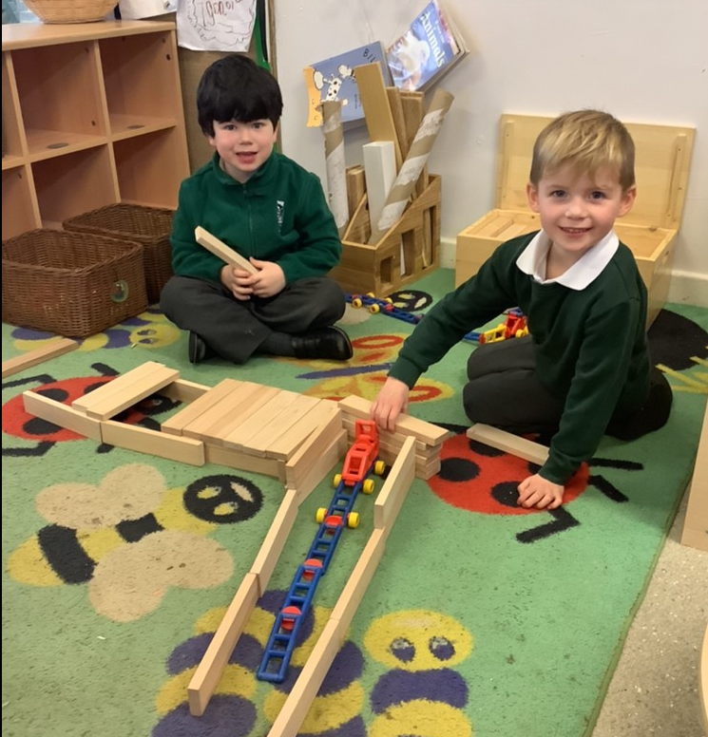
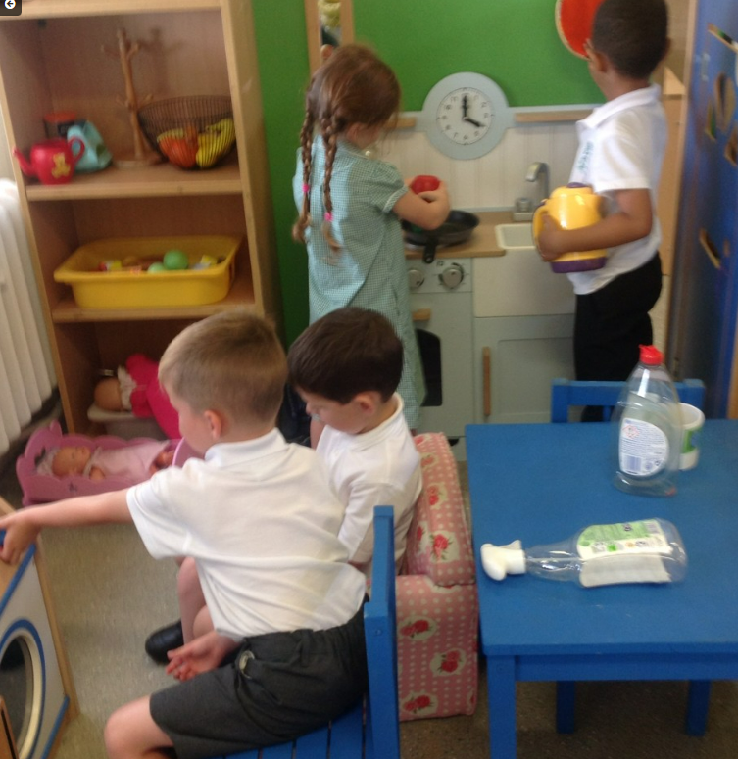
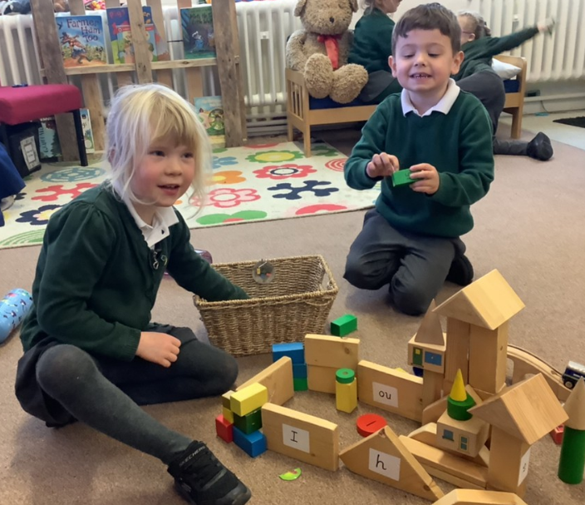
Inside our classroom…

Slide 15
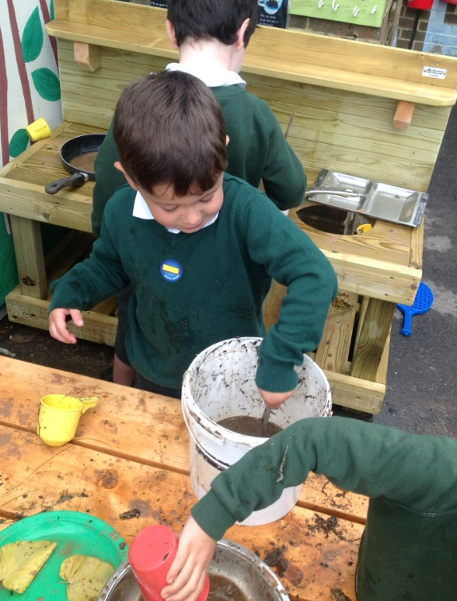
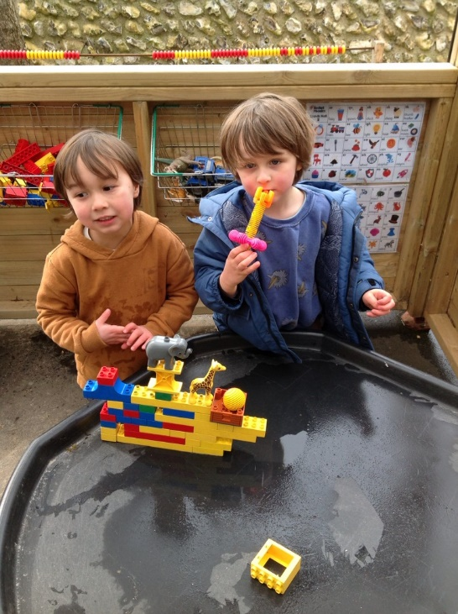
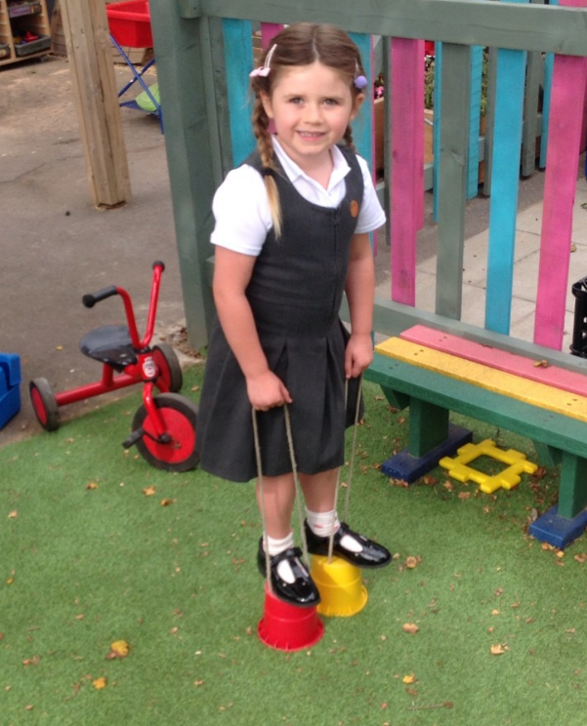
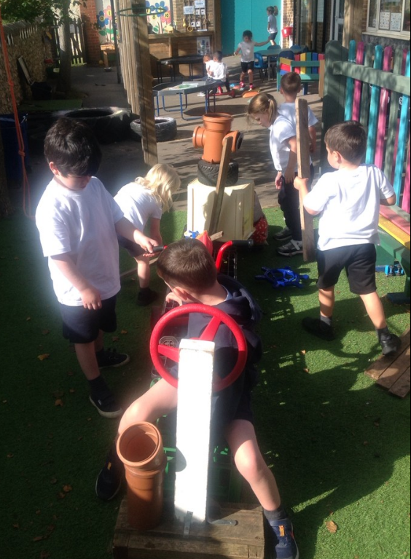
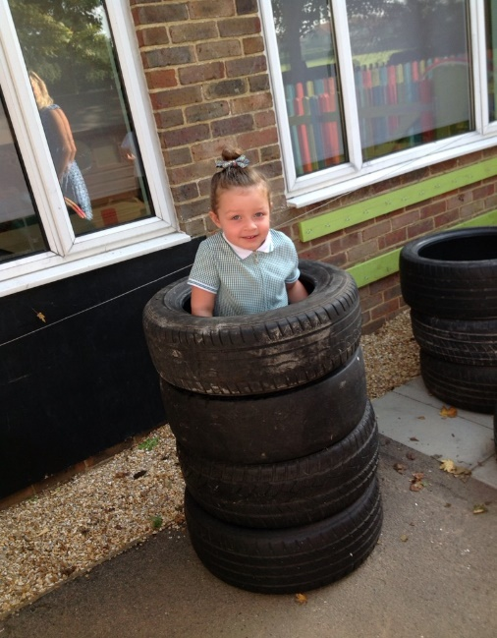
In our garden…

Slide 16
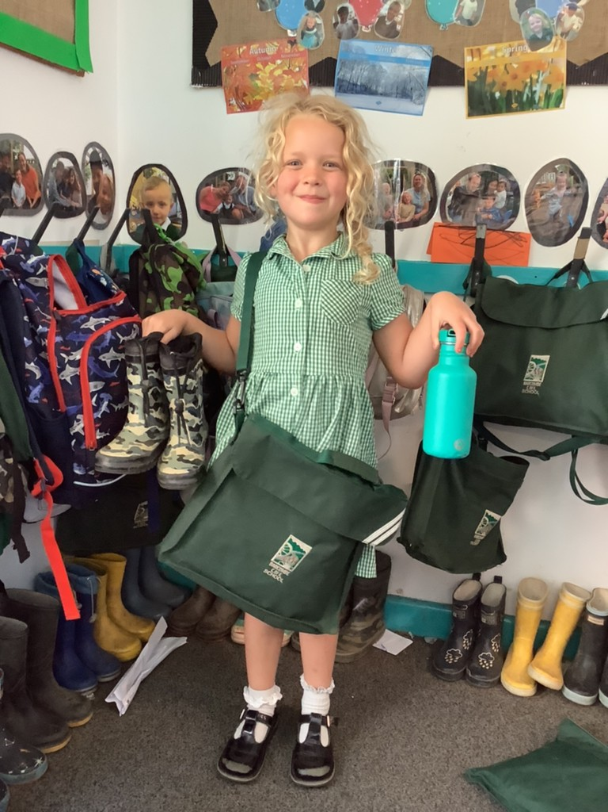
What do I need to bring?
School Uniform
Bag with a change of clothes
Welly Boots
Water bottle
Something special
Healthy snack – Fruit/
oat bar/crackers/rice cake
I will give you your book bag
on your first day at school.
Please make sure everything is named.

Slide 17
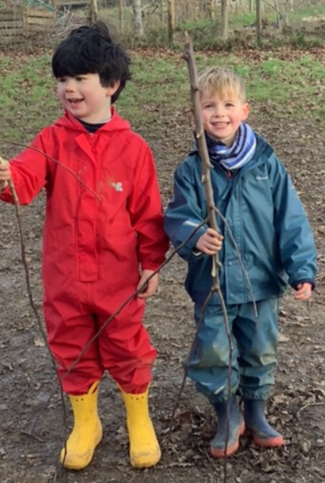
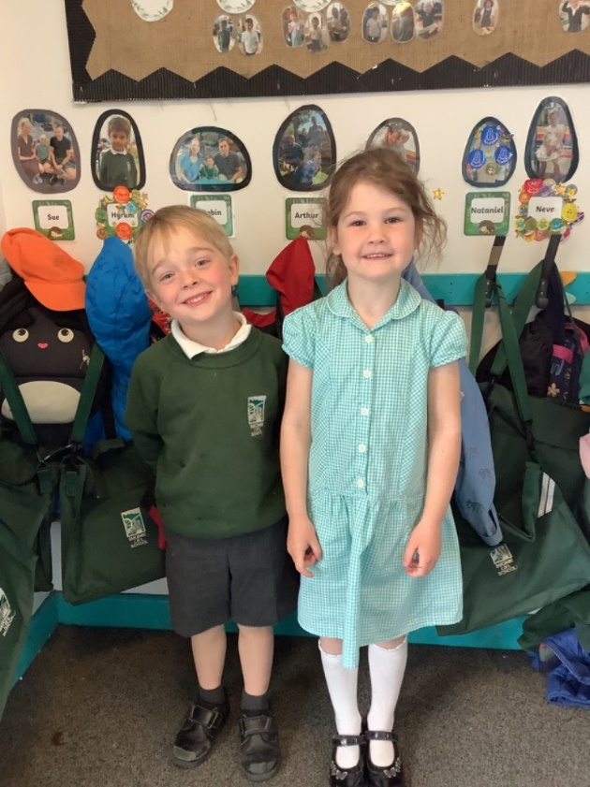
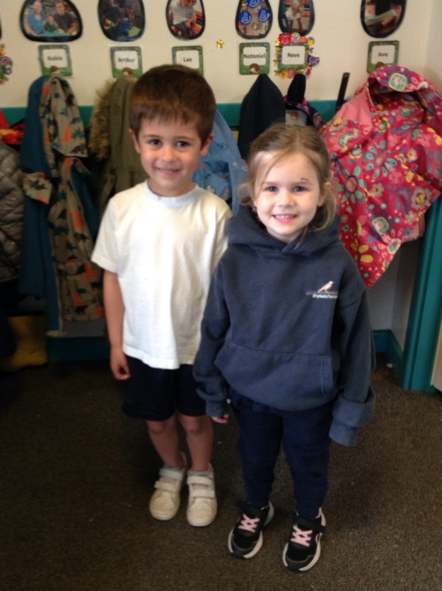
School Uniform
On PE days we come to school in our PE kit for the day.
School Uniform
PE Kit Days
Welly Walk Days!

Slide 18
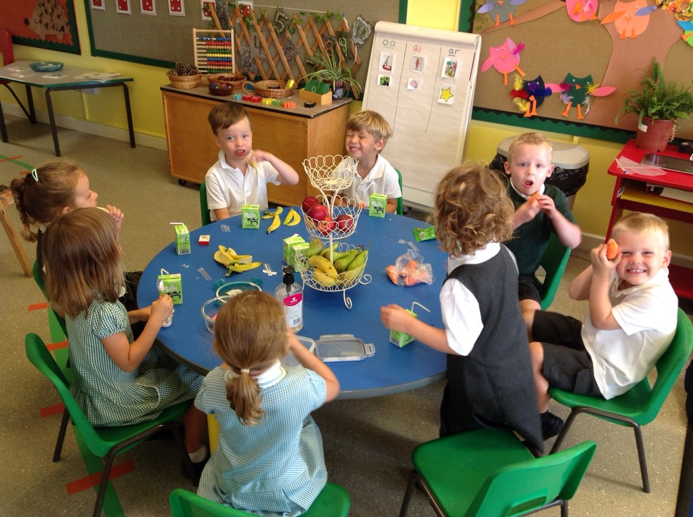
Snack time
Everyday we have a selection of fruit available for snack time.
You may want to send in a healthy snack that you know your child will eat as well. Please pop it in a named pot.
Milk is free and
available to all
children under
5 years old.

Slide 19
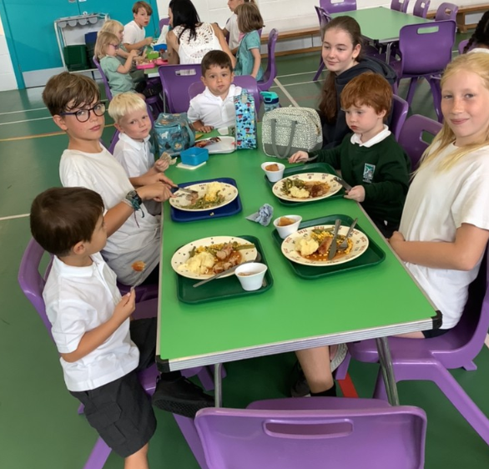
Lunch time
Free school meals for reception children.
Or choose to bring a packed lunch.
Lunch menu is in your pack.
Parents order online.
We will all sit together and our
Year 6 buddies will help us.
Miss Eaglen will settle the
children in the lunch hall/Sports hall.
After lunch, we all go out to
the Playground for a play
with our friends and year 6
buddies.

Slide 20
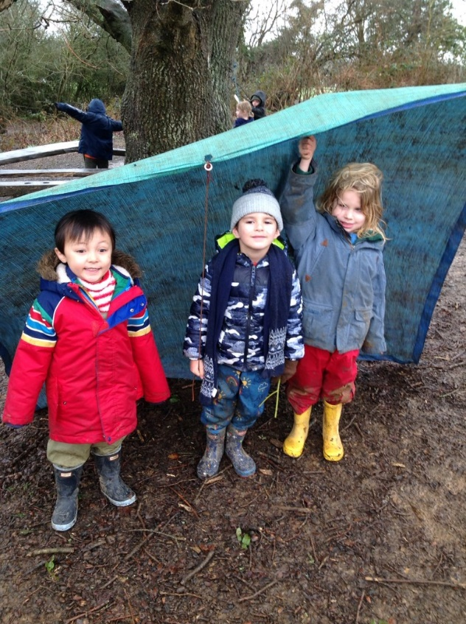
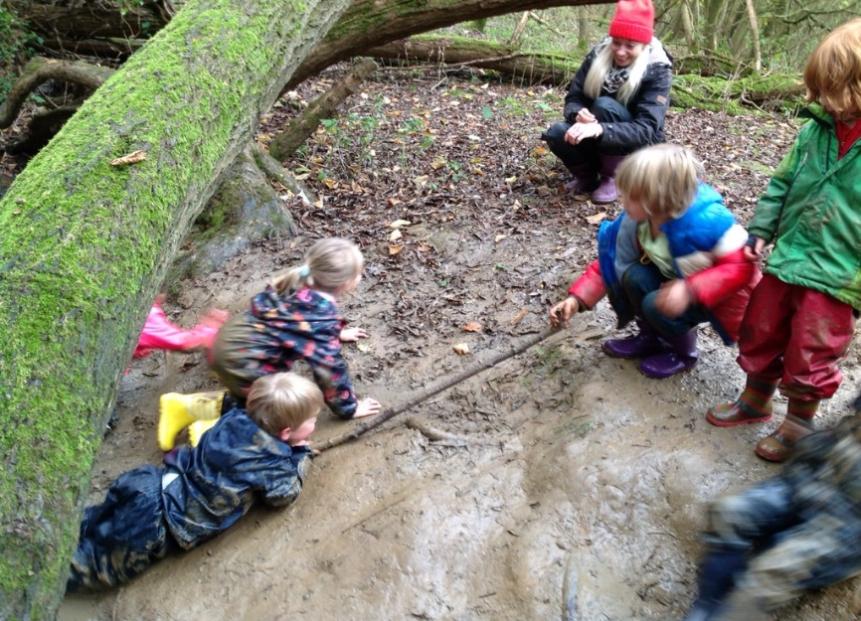
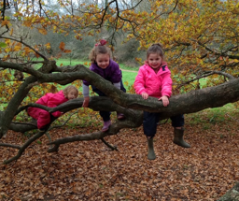
Welly walks
Every Wednesday we go on a Welly Walk to Wild About Barcombe.
We wear our old clothes and a waterproof suit, so we can have lots of fun and keep dry and warm.
This is super time to grow our
friendships and self-confidence.
There is no such thing a bad weather!

Slide 22
If you have questions do contact the school office and we will respond.
Miss Eaglen can give you a call if necessary.

Slide 23
Please come and join us!

