Slide 1

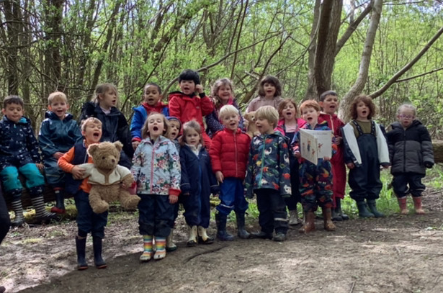
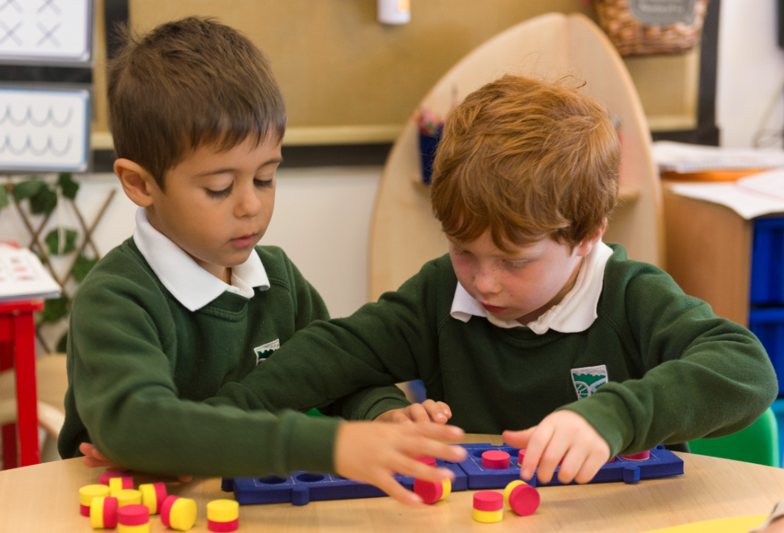
Welcome to Barcombe
CE Primary School
A small and mighty school where everyone flourishes in the heart of the community.

Slide 2
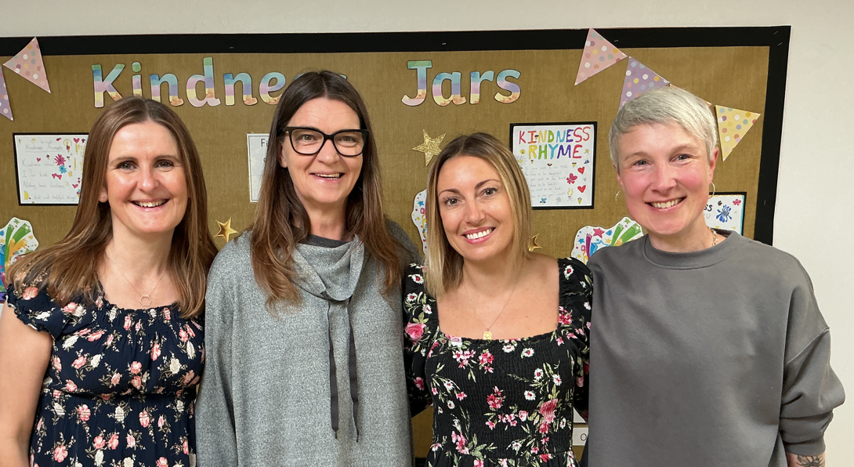
Hedgehogs Class
13 Reception Children
8 Year 1 Children
Class Teachers
Mrs Wilkins – Monday, Tuesday, Wednesday
Mrs Payne – Thursday, Friday
Support Staff
Mrs Kirsty Hills – Teaching Assistant
Ms Elphick – Individual Needs Assistant

Slide 3
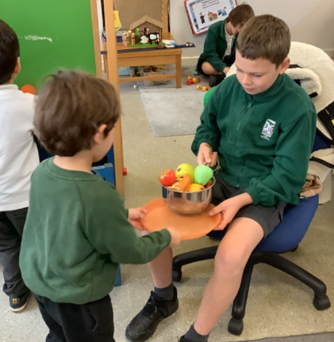
Supporting Transition
School Lunch – Taster Session
Thursday 25th June 12.30-1.00pm
Meet Year 6 buddies. They will be there to help as you try food from our menu.
Stay and Play Sessions
Group A –Monday 29th June, 1.30-2.30pm
Group B –Wednesday 1st July, 1.30-2.30pm
Meet Year 6 buddies again and explore the classroom.
Staggered Start Dates
Staggered start dates have been emailed to you.
Nursery and Playgroup Visits
We will visit your child in their nursery/playgroup setting to carry out a handover meeting with your child’s key worker.

Slide 4
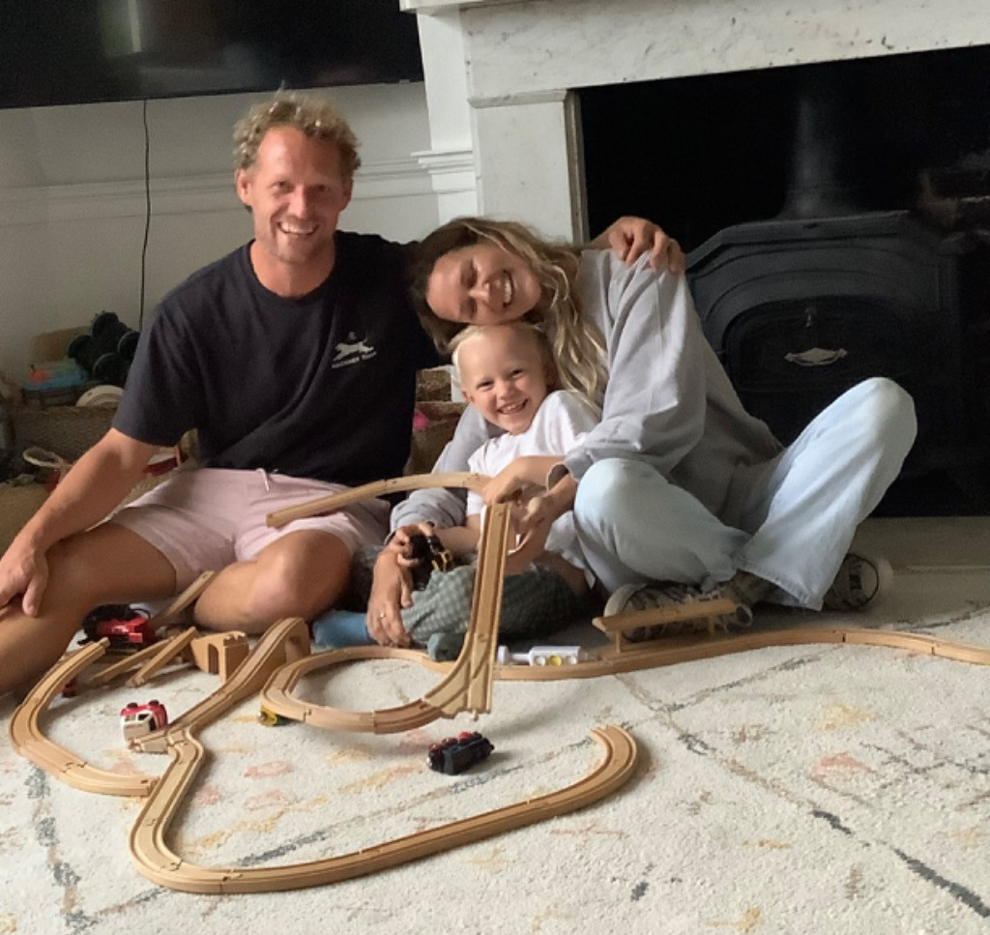
Home Visits – 8th and 9th September
An opportunity for us to meet you and your child in a relaxed home environment.
Time to talk with you about your child, in a confidential space.
A chance to ask any questions
and share any key worries or
information.
Time to get to know your child and find out about their favourite toy!

Slide 5
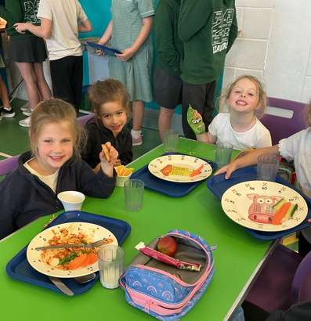
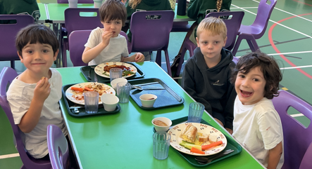
Staggered Start
Two morning sessions and two afternoon sessions.
Smaller groups so we can all get to know each other.
All children have experience of lunch times.
Full time timetable from Wednesday 16th September.

Slide 6
Hedgehogs Daily Timetable
8.35 to 8.45 - Children arrive at school
8:45 to 9:00 – Soft start with self-initiated play
Morning Session
Teacher led whole class sessions - Phonics, Maths, Literacy
Snack and Milk
Self-initiated learning and focus group work
12:00 to 1:00 - Lunch time
Afternoon Session
Teacher led whole class sessions – Topic, PE, PSHE, RE, Science
Self-initiated learning and focus group work
Storytime
3.15 - Home time

Slide 7
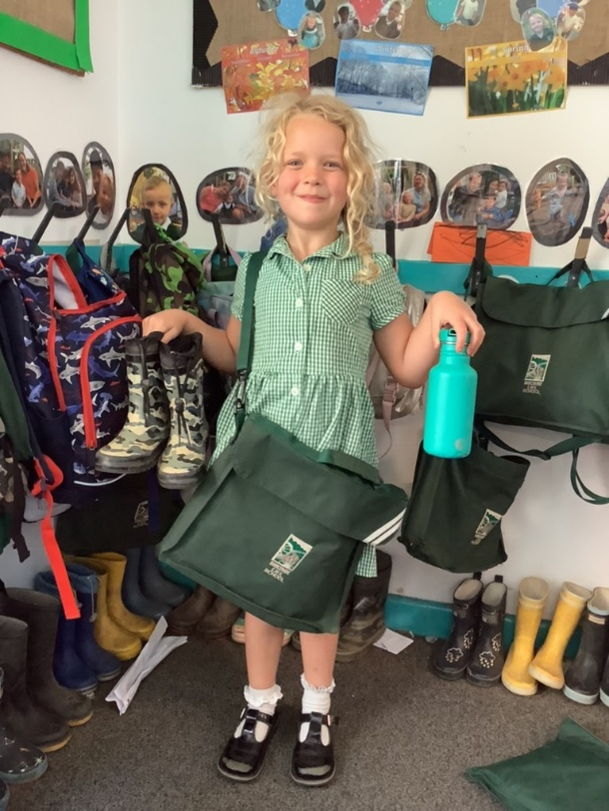
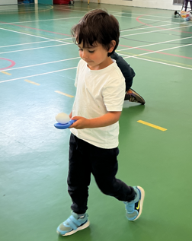
What do I need?
School uniform
Spare set of clothes
PE kit (wear this to school on PE days)
Welly boots
Book bag, book and reading record
Water bottle
Please label everything!

Slide 8
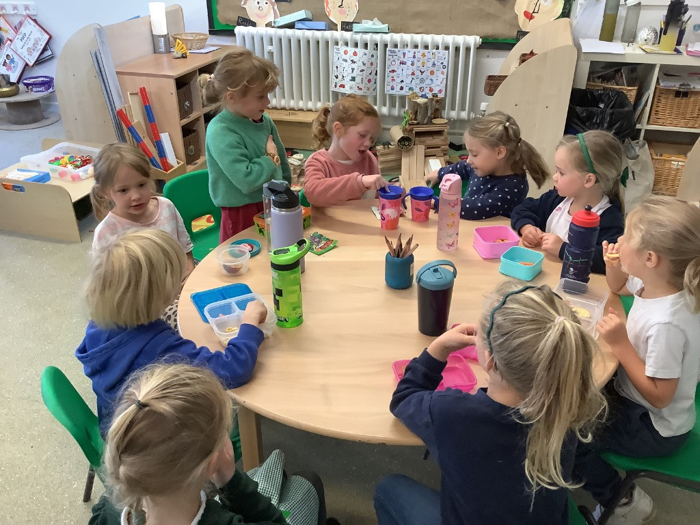
Snack Time
Everyday we have a selection of fruit available for snack time.
You may want to send in a healthy snack that you know your child will eat as well. Please pop it in a named pot and make sure it is NUT FREE.
Milk is free and available to all children under 5 years old.

Slide 9
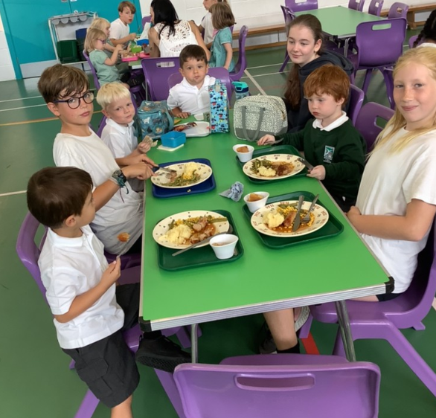
Lunch Time
Free school meals available to all or choose to bring a packed lunch.
Parents order lunch online.
Hedgehogs sit together and the Year 6 buddies help us.
After lunch, we all go out to the playground and play with our buddies and friends.

Slide 10


Further Information
After School Club - (Monday to Thursday)
3.15pm to 4.15pm - £5 4.15pm to 5.30pm - £6 3.15 to 5:30pm - £10
Please email the school office to book a space.
Tapestry is a secure online learning journal where we share your child’s learning. We upload photos, videos and observations from school. Parents can log in to view, comment and share learning from home.
Arbor is our online system for school communication. Parents can check messages, attendance and key information. It is also used for payments, trips and bookings, school dinner orders.

Slide 11


