Slide 1
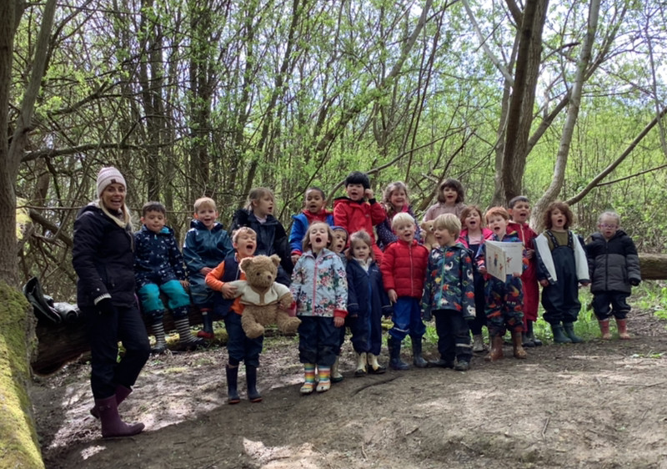
Welcome to Barcombe Primary School!

Slide 2
Class Structure
Hedgehog Class –
Miss Amy Eaglen – Class Teacher
Mrs Kirsty Hills–Teaching Assistant
Ms Elphick - INA

Slide 3
Early Years Foundation Stage Curriculum
Barcombe School follows the ‘Early Years Foundation Stage Guidance’ which supports each child to take their next steps and follow their learning interests.
Our curriculum is play-based, filled with practical and fun experiences to support thinking and learning.

Slide 4
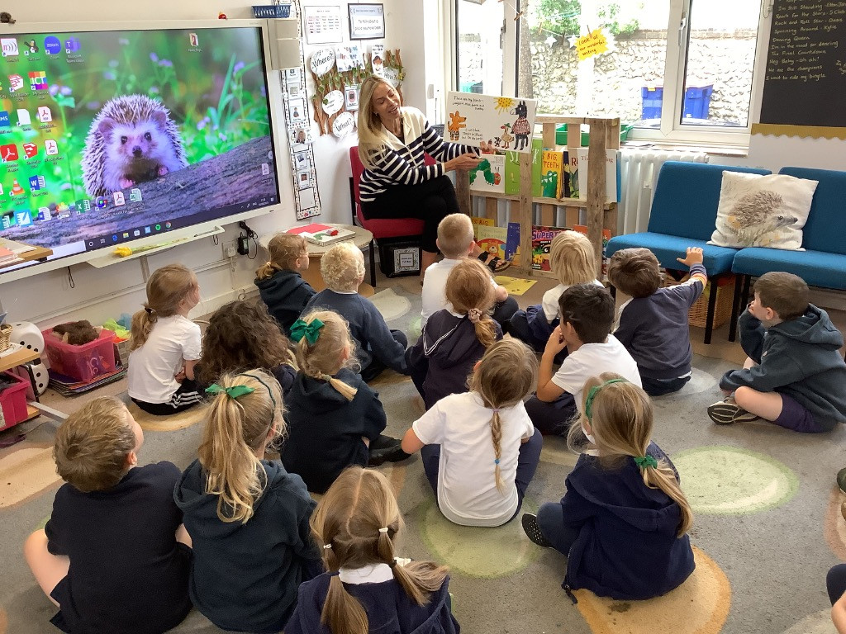
Transition from Pre-school
Handover from pre-schools / Playgroup
Playgroup play sessions in Hedgehog garden.
Transition story
and activities.

Slide 5
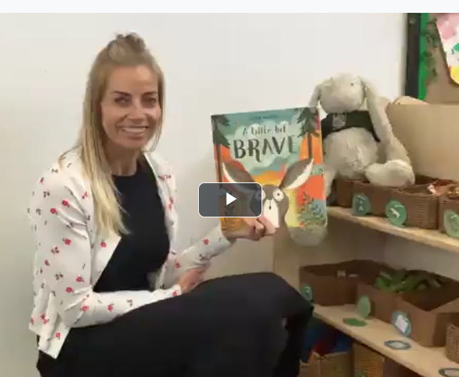
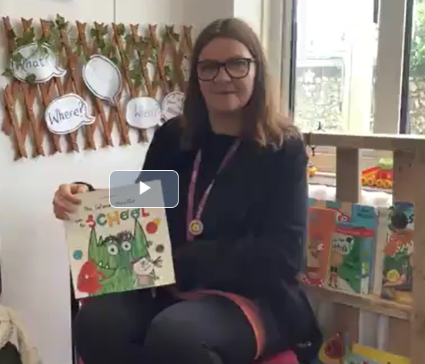
School Website Story Videos
Useful Information tab
New to Reception 2024

Slide 6
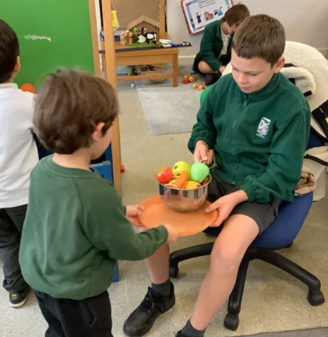
Stay and Play session
Group A –Tuesday 8th July 1.30-2.30pm
Group B -Wednesday 9th July
Meet your year 6 buddy.
Spend some time
in the classroom.
Half the class

Slide 7
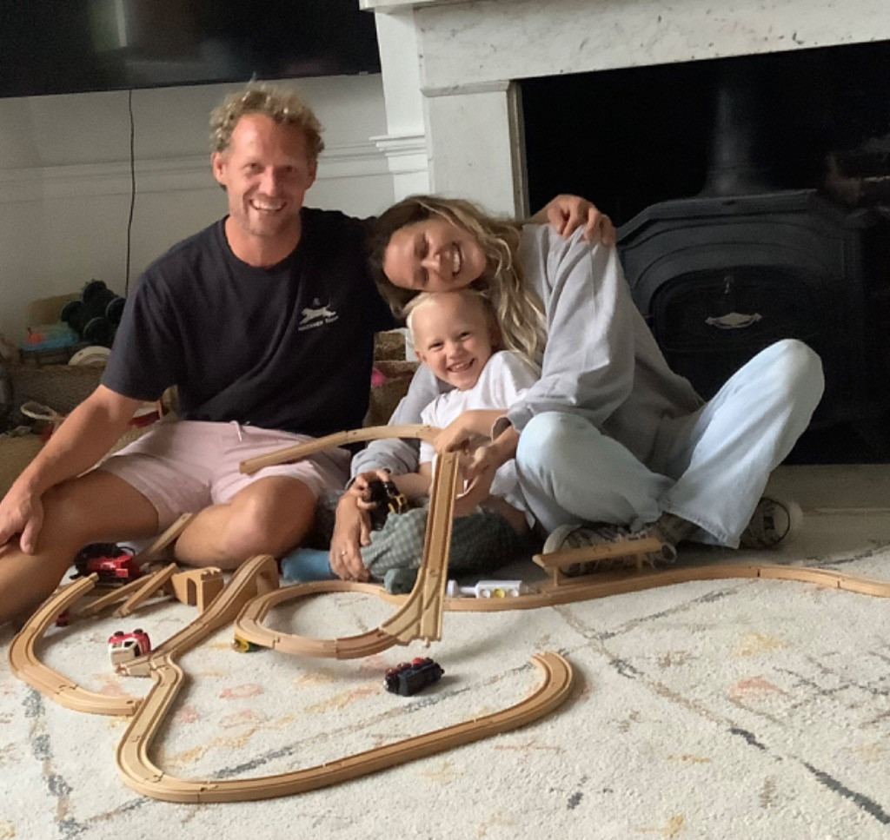
September – Home visits
Home Visits – September 8th / 9th / 10th
An opportunity for us to meet you
and your child in a relaxed home
environment.
Time to talk with you about your
child’s experiences so far.
A chance to ask any questions
and share any key worries or
information.
Time to reacquaint ourselves
before starting school.

Slide 8
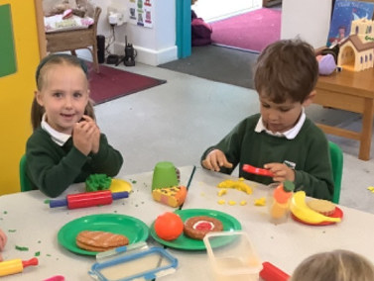
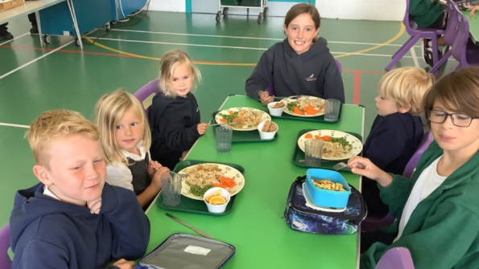
Staggered Start-
2 morning sessions and 2 afternoon sessions.
Smaller groups so we can all get to know each other.
All children have experience of lunch times before full time.
All children come full time from Wednesday 17th September.
Option to build up to full time.
We want starting school to be a positive
and happy next step for all children.

Slide 9
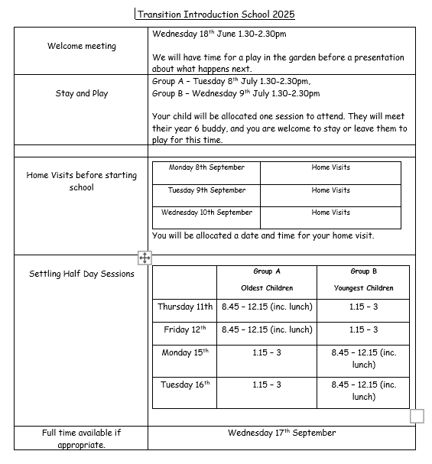
Transition events sheet is in your pack.

Slide 10
Parent What’s App Group
Parent Rep is Emma Stroude.
Setting up a What’s App Group to share important messages about school.
Building a sense of community and support.

Slide 11
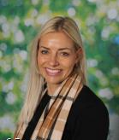
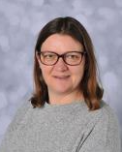
Meet your teacher
Miss Eaglen will be your
teacher in September.
Mrs Hills will be your TA.
Please ask us any questions
& say hello today!

Slide 12
A day in Hedgehog Class…
8.30-8.45 Parents can bring children into Hedgehog class and settle them and say goodbye.
8:45-9:00 Self-initiated play inside/outside
9.00 – 10.00 Maths or literacy
Teacher led focus groups / self-initiated learning inside and outside
10:00-10:30 Snack and milk and relax time
10.30 - 11.00 Phonics
11.00 – 12.00 Maths or literacy
Teacher led focus groups / self-initiated learning inside and outside
12:00-1:00 Lunch time
1:00-1:15 Register and relax time/circle time
1:15-2.30 Topic learning, 1:1 Reading, teacher led focus groups /self-initiated learning
2.30-3.00 Show and Tell, and Story

Slide 13
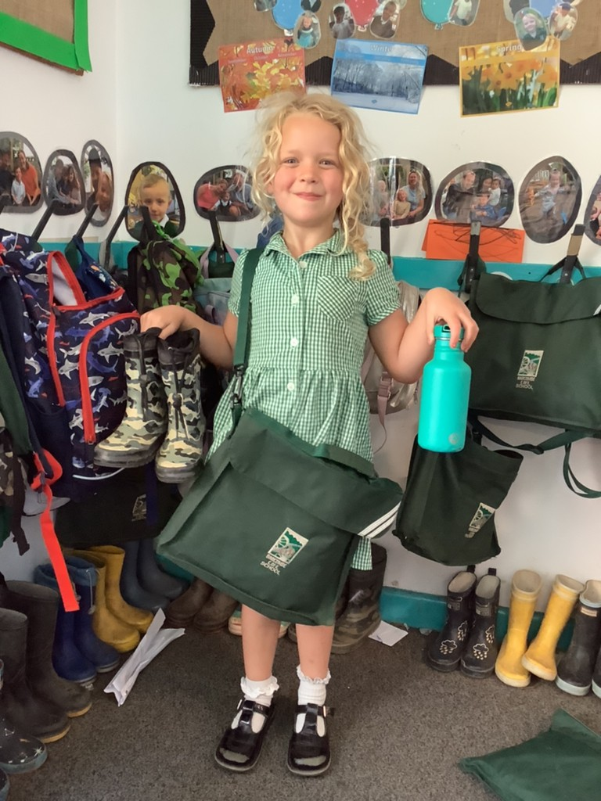
What do I need to bring?
School Uniform
Bag with a change of clothes
Welly Boots
Water bottle
Healthy snack (morning)
I will give you your book bag
on your first day at school.
Please make sure everything is named.

Slide 14
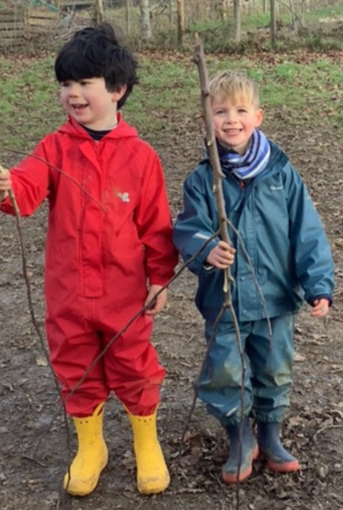
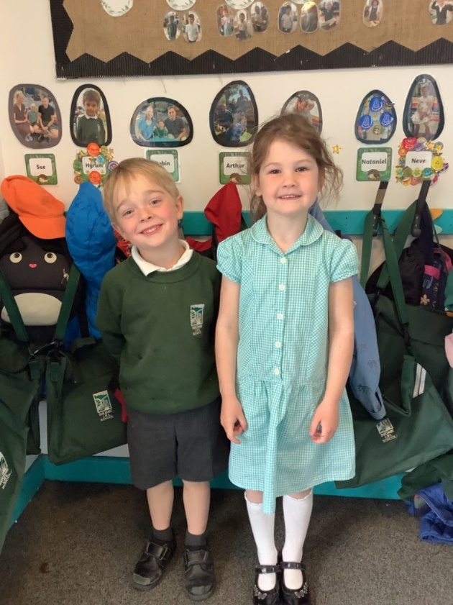
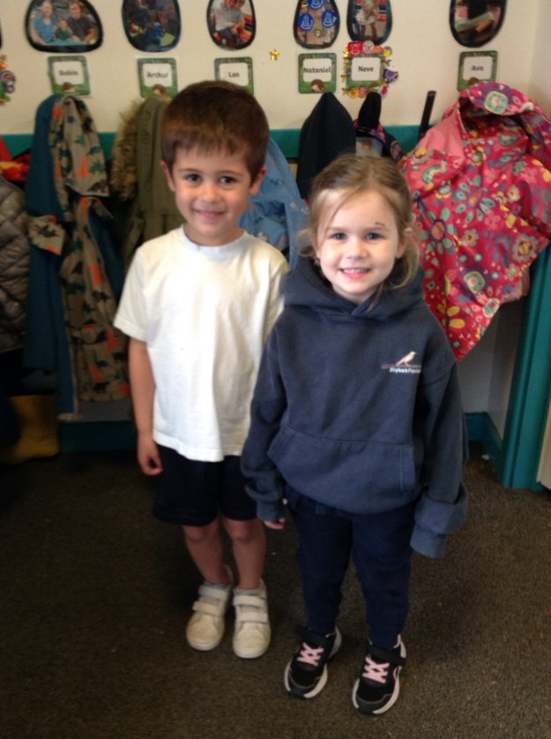
School Uniform
On PE days we come to school in our PE kit for the day.
School Uniform
PE Kit Days
Welly Walk Days!

Slide 15
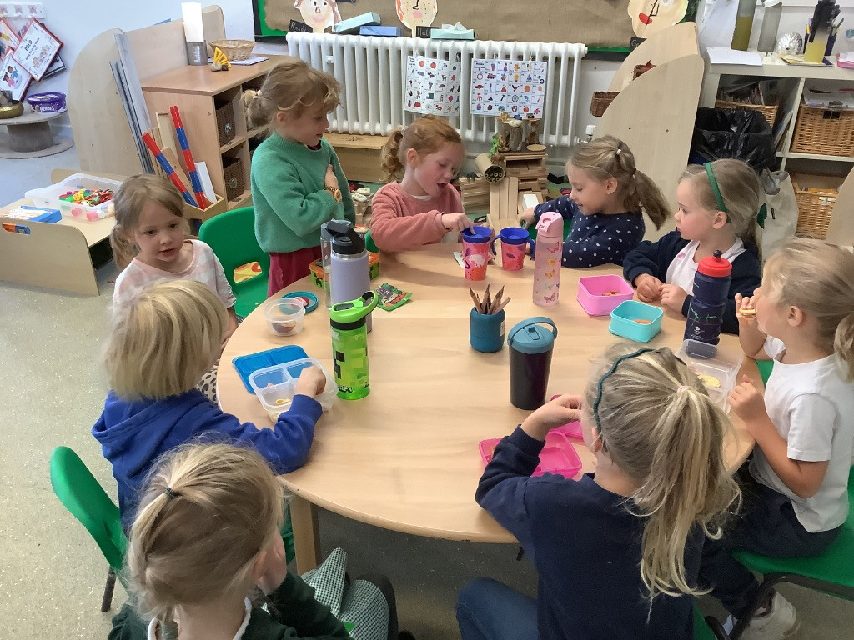
Snack time
Everyday we have a selection of fruit available for snack time.
You may want to send in a healthy snack that you know your child will eat as well. Please pop it in a named pot.
Milk is free and
available to all
children under
5 years old.

Slide 16
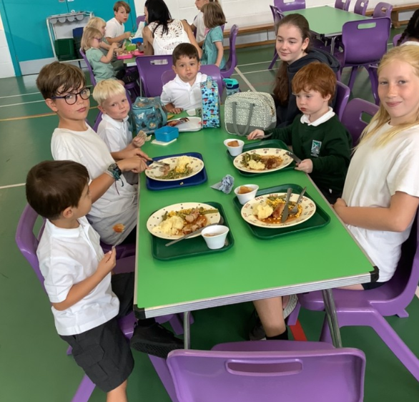
Lunch time
Free school meals for reception children.
Or choose to bring a packed lunch.
Parents order online.
We will all sit together and
our Year 6 buddies will
help us.
After lunch, we all go out to
the Playground for a play
with our friends and year 6
buddies.

Slide 17
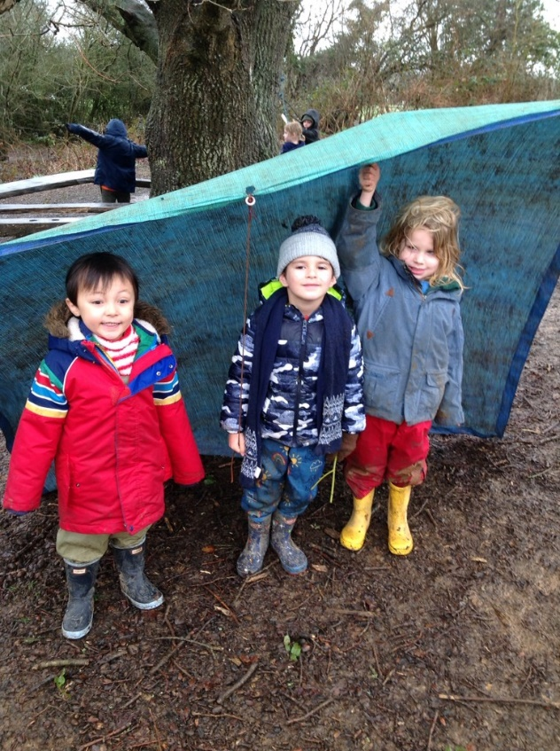
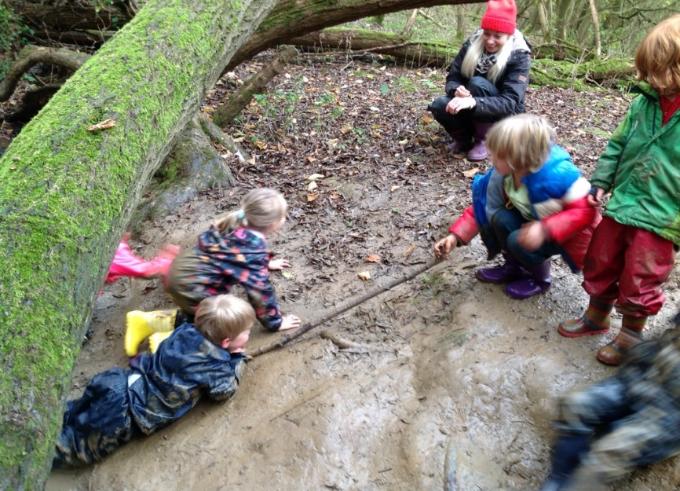
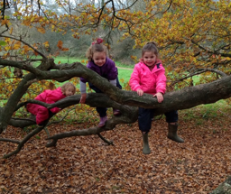
Welly walks
Every Wednesday we go on a Welly Walk to Wild About Barcombe.
We wear our old clothes and a waterproof suit, so we can have lots of fun and keep dry and warm.
This is super time to grow our
friendships and self-confidence.
There is no such thing a bad weather!

Slide 18
Wrap around care
Breakfast Club -£7 per session
7.45 – 8.40am
After School Club
3.15 – 4.15pm (£6)
3.15 – 5.00pm (£10)
3.15 – 6.00pm (£13.50)
Details are on the website.
Please email Miss Rose in the Office to arrange attending sessions.

Slide 19
A snapshot into Hedgies….

Slide 20
If you have questions do contact the school office and we will respond.
Miss Eaglen can give you a call if necessary.

Slide 21
Please come and join us!

